Slide 1
FINA 1303 THE BUY-SIDE: INSTITUTIONAL INVESTORS
Veronique Lafon-Vinais
Associate Professor of Business Education - Department of Finance

Slide 2
Course Map
Overview
Foundations
of
Interest Rates
Financial Institutions
Pricing of Financial Assets
Regulations
DCF
Sell Side
Buy Side
Stock
Valuation
Banking Regulation
Basics of
Interest
Rates
Commercial
Banking
Traditional Institutional Investors
Asset
Pricing
Models
Monetary Policy
Investment Banking
Alternative Investors
2

Slide 3
The Buy-Side
Traditional Institutional Investors:
Insurance Companies
Pension Funds and Retirement Schemes
Mutual Funds & Funds Management
Alternative Investors:
SWF
Hedge Funds
VC Firms & Private Equity

Slide 4
Course Map
Overview
Financial Institutions
Sell Side
Buy Side
Insurance Companies
Pension Funds and Retirement Schemes
Mutual Funds and Fund Management
Commercial Banking
Traditional Institutional Investors
Investment Banking
Alternative Investors
Spring 10

Slide 5
Insurance Companies
Definition
Fundamentals of insurance
Business model and organization of insurance industry
Types of insurance
Insurance in HK

Slide 6
Definition of insurance
Insurance provides indemnification against loss or liability from specified events and circumstances which may occur or be discovered during a specified period (FASB 113)
The essence of insurance is the transfer of risk from the insured to one or more insurers
Insurance companies are financial intermediaries who collect premiums and invest them in securities and other financial assets
Notes:
Insurance companies assume the risk of their clients in return for a fee, called the premium
Primary function is to compensate individuals and corporations (policyholders) if a pre-specified adverse event occurs
Most people purchase insurance because they are risk-averse - they would rather pay a certainty equivalent (the premium) than accept a gamble
How much risk a contract actually transfers proved to be at the heart of the controversy.
This issue arose most clearly in reinsurance, where the use of Financial Reinsurance to reengineer insurer balance sheets under US GAAP became fashionable during the 1980's. The accounting profession raised serious concerns about the use of reinsurance in which little if any actual risk was transferred, and went on to address the issue in FAS 113, cited above. While on tis face, FAS 113 is limited to accounting for reinsurance transactions, the guidance it contains is generally conceded to be equally applicable to US GAAP accounting for insurance transactions executed by commercial enterprises

Slide 7
Definition of Insurance
Benefit provided by a particular kind of indemnity contract, called an insurance policy
Issued by one of several kinds of legal entities, any of which may be called an insurer
In which the insurer promises to pay on behalf of or to indemnify another party, called a policyholder or insured
That protects the insured against loss caused by those perils subject to the indemnity in exchange for consideration known as an insurance premium
Notes:
What is Insurance?
(Source: http://www.hkfi.org.hk/en_tips.htm)
The idea of insurance is that if a large number of people each pays some money into a pool, then sizeable sums of money can be drawn from the pool to ease the hardship of those who might suffer losses. In short, insurance is the science of spreading risks.
In practice, insurers manage the money (called 'premium') paid by policyholders. In good years when claims are few, insurers are able to build up substantial reserves of money to cater for bad years when claims are heavy. Insurers are responsible for managing their business carefully so that they remain financially sound to pay out claims at all times.

Slide 8
Fundamentals of Insurance
Seven basic principles all insurance companies are subject to:
There must be a relationship between the insured and the beneficiary. Further, the beneficiary must be someone who would suffer if it weren’t for the insurance.
'Insurable Interest' is the right of the policyholder to effect insurance, arising out of certain relationships that may exist between the policyholder and the subject matter insured. Generally speaking, if the policyholder suffers direct losses arising from the subject matter's meeting with misfortune, then Insurable Interest exists. Without Insurable Interest, insurance protection would be speculative in nature, and not be enforceable under the law
Source: Mishkin/Eakins

Slide 9
Fundamentals of Insurance (Cont)
2. The insured must provide full and accurate information to the insurance company.
The insurer trusts the policyholder to give precise and true details of the subject matter to be insured. This is called the principle of 'Utmost Good Faith'
3. The insured is not to profit as a result of insurance coverage
By the principle of 'Indemnity', an insurance policy compensates the policyholder only to the extent of the value of the property which he has lost, hence a policyholder should not expect to make any profit from a claim.
4. If a third party compensates the insured for the loss, the insurance company’s obligation is reduced by the amount of the compensation
For policies to which 'Indemnity' applies, the purchase of several policies to cover the same subject matter will not result in the obtaining of claims payments of several times the value of the subject matter. The insurers simply 'contribute' to make up the amount payable as if only one policy had been issued.
Source: Mishkin/Eakins
Notes:
What is Insurance?
(Source: http://www.hkfi.org.hk/en_tips.htm)
The idea of insurance is that if a large number of people each pay some money into a pool, then sizeable sums of money can be drawn from the pool to ease the hardship of those who might suffer losses. In short, insurance is the science of spreading risks.
In practice, insurers manage the money (called 'premium') paid by policyholders. In good years when claims are few, insurers are able to build up substantial reserves of money to cater for bad years when claims are heavy. Insurers are responsible for managing their business carefully so that they remain financially sound to pay out claims at all times.
Insurance contracts are based on trust. The insurer trusts the policyholder to give precise and true details of the subject matter to be insured. This is called the principle of 'Utmost Good Faith'. Care should always be taken to tell the whole truth so that insurance companies can be fair in their assessment of risk. Equally, having effected an insurance policy the policyholder should read all the documentation very carefully to ensure that he understands the exact nature of the policy he has bought and the risks it does and does not cover.
Insurable Interest
'Insurable Interest' is the right of the policyholder to effect insurance, arising out of certain relationships that may exist between the policyholder and the subject matter insured. Generally speaking, if the policyholder suffers direct losses arising from the subject matter's meeting with misfortune, then Insurable Interest exists. Without Insurable Interest, insurance protection would be speculative in nature, and not be enforceable under the law.
The most common example of Insurable Interest is the ownership of property. There are many other examples, such as being an employer of workers, or a custodian of assets.
Sometimes during the term of an insurance policy, the policyholder might end the relationship with the subject matter insured. If this happens, Insurable Interest ceases and the insurance cover also automatically ends. A common example might be the sale of a car or a flat. The policyholder should take care to notify the insurer of such changes promptly.
Indemnity
By the principle of 'Indemnity', an insurance policy compensates the policyholder only to the extent of the value of the property which he has lost, hence a policyholder should not expect to make any profit from a claim.
Indemnity applies to all classes of insurance but is not always easily discernable in certain classes like 'Personal Accident' or 'Life Assurance'. In theory, human life is invaluable but with Accident and Life coverage the insurers will review circumstances of the applicants to determine the amount of coverage that they can reasonably issue to cover any projected loss.
For the insurance of property, if the insured subject matter has depreciated in value at the time it is lost, the insurer pays the policyholder only the depreciated value. This is called 'Indemnity Basis'. There is an alternative arrangement called 'Reinstatement Value Basis' which pays for the new replacement value at the time of loss without deducting depreciation.
Contribution
For policies to which 'Indemnity' applies, the purchase of several policies to cover the same subject matter will not result in the obtaining of claims payments of several times the value of the subject matter. The insurers simply 'contribute' to make up the amount payable as if only one policy had been issued.
For policies to which 'Indemnity' does not apply, the contribution factor does not apply either.

Slide 10
Fundamentals of Insurance (Cont)
Large number of homogeneous exposure units
The insurance company must have a large number of insured so that the risk can be spread out among many different policies (to apply the law of large numbers) – but there are exceptions to this rule (e.g. Satellite Launch insurance )
Calculable loss: the loss must be quantifiable
For example, an oil company could not buy a policy on an unexplored oil field
The insurance company must be able to compute the probability of the loss occurring
The law of large numbers says that when many people are insured, the probability distribution of the losses will assume a normal probability distribution, which allows accurate predictions
Source: Mishkin/Eakins
Notes:
The law of large numbers says that when many people are insured, the probability distribution of the losses will assume a normal probability distribution, which allows accurate predictions.
The existence of a large number of homogeneous exposure units allows insurers to benefit from the so-called “law of large numbers”, which in effect states that as the number of exposure units increases, proportionally the actual results are increasingly likely to become close to expected proportions

Slide 11
Summary
definition of insurance
7 basic principles of insurance

Slide 12

Test your understanding
Which principle of insurance most distinguishes insurance from derivatives?
Insurable Interest
Utmost Good Faith
Indemnity
Which principle of insurance explains why you can buy health insurance cheaper through your employer than individually?
Insurable Interest
Law of Large Numbers
Indemnity

Slide 13
Why get insured?
Premiums are likely to be more than the expected loss → why get insurance?
If there is no insurance:
Need to set aside reserves for losses
Reserves cannot be invested long term as need to be immediately accessible in case of loss (liquidity) => low return
Worry that level of reserves may not be adequate to cover the loss
Most people are risk-adverse: they would rather pay a certainty equivalent (the insurance premium) than accept the gamble that they will lose their house/car → insurance allows peace of mind that a single event can have only a limited financial impact
Trade-off: cost of premium vs. probability of occurrence and likely loss

Slide 14
Adverse Selection & Moral Hazard in Insurance
Adverse selection
Moral hazard
= which policies to accept
Solutions:
Screening and fraud prevention investigations
Health insurance policies require a physical exam
Preexisting conditions may be excluded from the policy
= when the insured fails to take proper precautions (or takes on more risk) to avoid losses because losses are covered by the insurance policy
Solution:
Insurance companies use co-insurance, deductibles and restrictive provisions to help control this problem
A deductible is the amount of any loss that must be paid by the insured before the insurance company will pay anything
Source: Mishkin/Eakins
Notes:
Restrictive provisions discourage policy holders from engaging in risky activities that make an insurance claim more likely, or may require certain behavior on the part of the insured that makes a claim less likely. Similar to restrictive covenants in debt contracts.
Co-insurance is when a policyholder shares a percentage of the losses along with the insurance company.

Slide 15
How do insurance companies make profits?
Profit = earned premium + investment income - incurred loss - underwriting expenses
Insurers make money in two ways:
Through underwriting, the process by which insurers select the risks to insure and decide how much in premiums to charge for accepting those risks;
An insurer's underwriting performance is measured in its combined ratio which is the ratio of losses and expenses to premiums. A combined ratio < 100 % indicates underwriting profitability, while anything over 100 indicates an underwriting loss. A company with a combined ratio over 100% may nevertheless remain profitable due to investment earnings
By investing the premiums they collect from insured parties
Insurance companies earn investment profits on “float”. “Float” or available reserve is the amount of money, at hand at any given moment, that an insurer has collected in insurance premiums but has not paid out in claims
Notes:
Source: Wikipedia http://en.wikipedia.org/wiki/Insurance#Principles_of_insurance
The most complicated aspect of the insurance business is the underwriting of policies. Using a wide assortment of data, insurers predict the likelihood that a claim will be made against their policies and price products accordingly. To this end, insurers use actuarial science to quantify the risks they are willing to assume and the premium they will charge to assume them. Data is analyzed to fairly accurately project the rate of future claims based on a given risk. Actuarial science uses statistics and probability to analyze the risks associated with the range of perils covered, and these scientific principles are used to determine an insurer's overall exposure. Upon termination of a given policy, the amount of premium collected and the investment gains thereon minus the amount paid out in claims is the insurer's underwriting profit on that policy. Of course, from the insurer's perspective, some policies are "winners" (i.e., the insurer pays out less in claims and expenses than it receives in premiums and investment income) and some are "losers" (i.e., the insurer pays out more in claims and expenses than it receives in premiums and investment income); insurance companies essentially use actuarial science to attempt to underwrite enough "winning" policies to pay out on the "losers" while still maintaining profitability.
An insurer's underwriting performance is measured in its combined ratio [6] which is the ratio of losses and expenses to premiums. A combined ratio of less than 100 percent indicates underwriting profitability, while anything over 100 indicates an underwriting loss. A company with a combined ratio over 100% may nevertheless remain profitable due to investment earnings.
Insurance companies earn investment profits on “float”. “Float” or available reserve is the amount of money, at hand at any given moment, that an insurer has collected in insurance premiums but has not paid out in claims. Insurers start investing insurance premiums as soon as they are collected and continue to earn interest or other income on them until claims are paid out. The Association of British Insurers (gathering 400 insurance companies and 94% of UK insurance services) has almost 20% of the investments in the London Stock Exchange [7].

Slide 16
Insurance industry organization
Distribution
Independent agents may sell the insurance products of a number of different insurance companies
Exclusive (captive) agents only sell the products of one company
Nowadays most insurance companies use multiple distribution channels, including banks, professional organizations, and market places
In the US, since 1999 other financial institutions have started competing directly with insurance companies to provide insurance service (e.g. bancassurance)
Underwriting
An underwriter reviews each policy prior to its acceptance to determine if the risk is acceptable.
Claims
The claim adjuster undertakes a thorough investigation of each claim, usually in close cooperation with the insured, determines if coverage is available under the terms of the insurance contract, and if so, the reasonable monetary value of the claim, and authorizes payment.
Notes:
Source: Marianne Purushotham, “The Impact of Distribution on the Individual Life and Annuity Industry,” The Actuary newsletter, June 2006.
Decline in full-time affiliated agents (LIMRA estimates)
In 1989: about 262,000
In 2001: about 178,000
In 2004: about 160,000
More than ¾ of independent agents began their careers as affiliated agents
In 2004 stockbrokers and banks wrote about 40% of new individual annuity premium but less than 10% of new individual life premium

Slide 17
Summary
reasons to get insured
adverse selection & moral hazard in insurance
business model for insurance companies

Slide 18
Test Your Understanding
How do insurance companies make profits?
Paying out less in claims then they receive in premiums
Investing the float to generate income
Premiums less claims paid plus investment income less operational expenses
None of the above

Slide 19
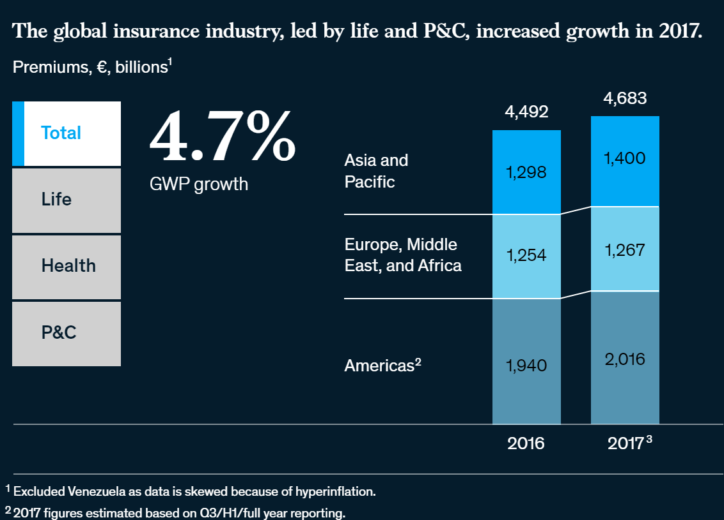
Global Insurance Market
Source: McKinsey 2019 Report on Global insurance
Notes:
Source: https://www.mckinsey.com/industries/financial-services/our-insights/2019-global-insurance-trends-and-forecasts

Slide 20
Life Insurance
Basic products of life insurance
Life Insurance: pays off if the insured dies
Term Life: the insured is covered while the policy is in effect, usually 10–20 years – no savings element
Whole Life: similar to term life, but allows the policyholder to borrow against the policies cash value. When the term of policy expires, the insured can get the cash value of the policy
Universal Life/Endowment Life/Variable Life: includes both a term life portion and a savings portion (savings component)
Disability: pays off if the insured becomes unable to continue working due to illness or accident
Annuities: pays a benefit to the insured until death, to cover retirement years
Life insurance companies can provide retirement benefits as well as life insurance: source of convergence of financial institutions
Source: Mishkin/Eakins
Notes:
Life insurance companies can provide retirement benefits as well as life insurance: the premium combines the cost of the life insurance with a saving program
Annuity: for an initial fixed sum or a stream of payments, the insurance company agrees to pay you a fixed amount for as long as you live => if you live very long, the insurance company pays out more than expected, but if you die early, it pays out less.
Term life: as insured ages, cost of policy rises; decreasing term policies have a constant premium but the amount of insurance coverage declines every year. The closest to pure life insurance. As long as premiums are up to date, beneficiary receives a payout at the time of the insured deaths during the coverage period. If insured lives beyond term of contract, policy expires along with any rights/benefits.
Whole life policies usually require the insured to pay a level premium for the duration of the policy. Protects individual during an entire lifetime rather than for a specified coverage period. In the beginning the insured pays more than for a term policy; this overpayment accumulates as cash value that can be borrowed by the insured at reasonable rates. Survivorship benefits also contribute to the accumulated cash values. When members of the insured pool die, any remaining cash values are distributed among the survivors. If the policyholder lives until the policy matures, it can be surrendered for its cash value. This cash value can be used to purchase an annuity. In the late 70s whole life policies fell out of favor because the rates of return earned on the policy premiums were well below rates available on other investments.
Universal life combine the benefits of the term policy with those of the whole life policy. Major benefit is that the cash value accumulates at a much higher rate. Structured to have 2 parts: one for the term life insurance and one for savings. Interest earned on the savings portion is tax-exempt until withdrawn. Cash value of the policy cannot exceed the death benefits. Universal life allows the insured to change both the premium amounts and the maturity of the life contract, unlike traditional policies that maintain premiums at a given level over a fixed contract period.
Endowment Life guarantees a payout to the beneficiary of the policy if death occurs during some endowment period (e.g. prior to reaching retirement age). A person who lives to the endowment date receives the face value of the policy
Variable life invests fixed premium payments in mutual funds of stocks, bonds and MM instruments. Policyholders can choose investments to reflect their risk profile. Variable life provides an alternative way to build savings compared to the more traditional policies such as whole life because the value of the policy increases/decreases with the asset returns of the funds in which premiums are invested.
Annuities can be viewed as insuring against life, basically the risk of outliving the retirement funds. Purchasing annuities guarantees payments as long as the beneficiary lives. Most annuities are sold to members of large groups where all employees covered by a particular pension plan automatically receive their benefit distribution by purchasing an annuity from the insurance company.

Slide 21
Life Insurance
Three basic classes
Three major other activities of life insurance companies:
Ordinary Life
Term Life
Whole Life
Endowment Life
Variable Life
Universal Life and Variable Universal Life
Group Life
Credit Life
Sales of annuities
Private pension plans
Accident and health insurance
Annuities represent the reverse of life insurance. They involve different methods of liquidating a fund over a long period of time, such as paying out a funds’ proceeds to the beneficiary.
Source: Saunders/Cornett
Notes:
Annuities represent the reverse of life insurance principles. While life insurance involves different contractual methods to build up a fund and the eventual payout of a lump sum to the beneficiary, annuities involve different methods of liquidating a fund over a long period of time, such as paying out a funds’ proceeds to the beneficiary. Different types of annuity contracts have been developed. They can be sold to an individual or a group and on either a fixed or variable basis by being linked to the return on some underlying investment portfolio. Individuals can purchase annuities with a single payment or payments spread over a number of years. Payments can be structured to begin immediately or they can be deferred (e.g. to start at retirement)
Fixed annuities guarantee that a specific sum of money will be paid each period, generally on a monthly basis, regardless of fluctuations in the value of the annuity issuer’s underlying investments.
Variable annuity payments are based on the portfolio of stocks in which the issuer invests; therefore the monthly payment may fluctuate, depending on whether the value of the investments goes up or down.
Annuities may also be classified as immediate, which begin to pay as soon as the premium is received, or deferred, which accumulate assets before payments begin, generally at retirement.
The equity index annuity is a hybrid annuity product. A specified rate of interest guarantees a fixed minimum rate of interest as with traditional fixed annuities. At the same time, additional interest may be credited to policy values based on positive changes, if any, in an established index such as the S&P 500.The amount of additional interest depends on the particular design of the policy. Policies are sold by licensed insurance agents and regulated by state insurance departments. Sales of index annuities reached a record $27.3 Billion in 2005, up 19% from $23 billion in 20004.
Annuities are very popular as savings/retirements tool because any interest earned on annuities is tax deferred, i.e. taxes are not paid until the annuity payments are actually paid to the beneficiary. In contrast to IRAs, the tax-deferred status of annual annuity contributions are not capped and are not affected by policyholders income level.
Group life insurance covers a large number of insured persons under a single policy. The policies may be contributory (both employee and employer share the cost) or non-contributory.
Credit life protects lenders against a borrower’s death prior to the repayment of a debt contract (e.g. mortgage). Usually the face amount of the policy reflects the outstanding principal and interest on the loan.

Slide 22
Health Insurance
Health insurance policies are highly vulnerable to the adverse selection problem
Those with known or expected health problems are more likely to seek coverage
This is why most health insurance is offered through group policies. Individual policies must be priced assuming adverse selection
Hot topic in the political environment, focusing on increased costs and availability of coverage
Insurance programs are attempting to shift costs to the employers
Health Maintenance Organizations (HMOs) are another attempt to keep costs down
The US government is also involved in health insurance through Medicare and Medicaid. Medicare provides coverage for the elderly, and Medicaid provides coverage for people on welfare.
Key issue: spiraling costs of health care
Source: Mishkin/Eakins
Notes:
Cost of healthcare has risen faster than the cost of living and real wages, One factor is the more sophisticated and expensive treatments constantly being offered.
Today the risk of most company-sponsored plans is borne by the company, with the insurance company administering the plan and covering catastrophic expenses.
Insurance companies also attempt to control the increased medical costs by negotiating contracts with physician groups to provide services at reduced costs and through managed care, where approval is required before services are rendered. Health Maintenance Organizations shift the risk from the insurance company to the provider. The insurance company pays the HMO a fixed payment per person covered in exchange for medical services. The provider then has an incentive to limit medical services.
One out of six Americans has no health insurance. That's a staggering 46 million people in this country who are completely uninsured, an unfathomable statistic for our nation. Two million others have only high-deductible health insurance.

Slide 23
Current issues in life and health insurance
2010 President Obama signed the Patient Protection and Affordable Care Act “Obamacare”, requiring most U.S. citizens to have health insurance.
PPACA reforms certain aspects of the private health insurance industry and public health insurance programs, increases insurance coverage of pre-existing conditions, expands access to insurance to over 30 million Americans, and increases projected national medical spending while lowering projected Medicare spending.
Source: Wikipedia
Notes:
a majority of the states, and numerous organizations and individual persons, have filed actions in federal court challenging the constitutionality of PPACA. As of January 2012, two of four federal appellate courts have upheld it; a third declared the individual mandate unconstitutional , while a fourth ruled the federal Anti-Injuction Act prevents the issue from being decided until taxpayers begin paying penalties in 2015. The Supreme Court has scheduled six hours for oral arguments March 26-28, 2012, and will issue its decision by the end of June

Slide 24
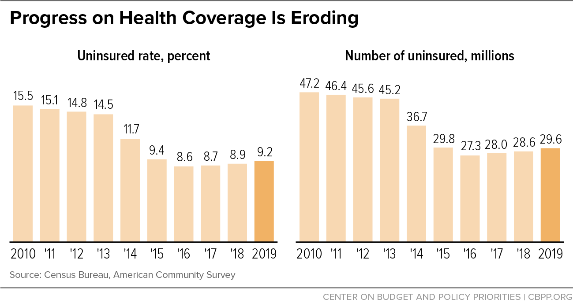
Impact of Trump on Obamacare
Notes:
Source: https://www.cbpp.org/progress-on-health-coverage-is-eroding Sept 2020 https://www.cbpp.org/research/health/uninsured-rate-rose-again-in-2019-further-eroding-earlier-progress?campaign_id=9&emc=edit_nn_20210128&instance_id=26537&nl=the-morning&regi_id=120139650&segment_id=50580&te=1&user_id=f8fda73b93abf2d282cd2859817a19cd#:~:text=Some%209.2%20percent%20of%20Americans,according%20to%20the%20ACS%20data

Slide 25
Property and Casualty Insurance
Property Insurance: earliest form of insurance; protects businesses and owners from the risk associated with owning property. Includes replacement and loss of earnings from income-producing property as well as financial losses to the owners of residential property
Named-peril policies: insures against any losses only from perils specifically named in the policy (e.g. flood insurance)
Open-peril policies: insures against any losses except from perils specifically named in the policy (e.g. homeowners insurance)
Casualty/Liability Insurance: protects against financial losses because of a claim of negligence (e.g. physician insurance; D&O liability insurance; product liability insurance against defects).
In the US liability premiums have risen considerably due to litigation (juries awarding high liability awards).
Source: Mishkin/Eakins
Notes:
Liability risk exposure is difficult to determine. It can have long lag times (“tails”): a liability claim can be filed long after the policy expires.

Slide 26
Summary
Life Insurance
Definitions
Classes and product categories, in particular
term life (as purest form of life insurance)
annuities
Health Insurance
Obamacare - purpose
Property and Casualty Insurance
D&O insurance

Slide 27
Test Your Understanding
What was the goal of Obamacare?
Ensuring that all Americans had health insurance
Ensuring that all Americans had life insurance
Ensuring that insurance companies were properly regulated in the US
Which type of insurance premiums has gone up significantly in the US due to corporate fraud?
Health insurance
Life insurance
D&O insurance

Slide 28

Reinsurance
Reinsurance = insurance for insurance companies
Allocates a portion of the risk to another company in exchange for a portion of the premium
Started in 17th century with Lloyds of London
Key issues in reinsurance: impact of catastrophic losses such as Katrina
One of the recent trends has been the crossover from reinsurance into capital markets (catastrophe bonds, mortality bonds) with growing role of hedge funds as investors
Source: http://www.freefoto.com
Notes:
The Lloyd's Building was designed by Richard Rogers, the same architect that designed the Pompidou Centre in Paris. Opened in 1986, it is one of the most well known modern buildings in London.
In the over-the-counter market, investment banks are acting as intermediaries to structure tailor-made longevity hedging strategies for sellers, which include pension funds and insurance companies Buyers of longevity risks include reinsurance companies and hedge funds, many of which already trade in other insurance-based securities such as mortality bonds. Mortality bonds are short-term coupons linked to occurrences such as natural disasters or disease outbreaks that cause people to die earlier than actuarially predicted.
David Blake, director of the Pensions Institute at Cass Business School in London who helped JPMorgan develop LifeMetrics. “We want this market to get started.” a platform, dubbed LifeMetrics, that has three components — the longevity index, different forecasting models that can be used to adapt to the population of a particular pension fund and hedging tools including derivatives and structured products. JPMorgan plans to expand it to other European countries and Canada.
Mr. Blake has been lobbying the U.K. government to issue longevity bonds to seed a capital market in longevity derivatives. The idea is similar to inflation-linked bonds, but following a longevity index. Payments would therefore rise as longevity increases, Mr. Blake said.
“Government-issued longevity bonds would help to set the risk-free term structure for longevity risks,” he said. “The government already does this in the inflation risk market as well as the fixed-income market.”
Reinsurance Reinsurance is essentially insurance for insurance companies. It is a way for primary insurers to protect against unforeseen or extraordinary losses. Reinsurance also serves to limit liability on specific risks, to increase individual insurers’ capacity to write business and to help insurers stabilize their business in the face of the wide swings in profit and loss margins that are inherent in the insurance business.
Reinsurance is an international business. According to the Reinsurance Association of America, 53.1 percent of the reinsurance purchased by U.S insurance companies was written by foreign reinsurance companies in 2006. If the domicile of the reinsurance company's parent is taken into account, foreign (or foreign-owned) reinsurance companies accounted for 84.5 percent of the market. This is because many U.S. reinsurance companies are owned by foreign firms.

Slide 29
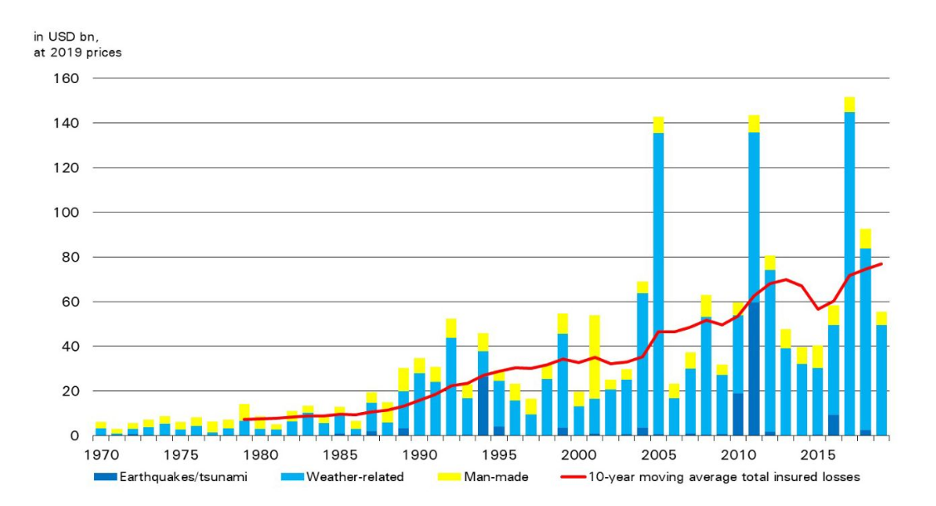
Catastrophic risk and insurance
Hurricanes Harvey, Irma and Maria, wildfires
Katrina
Fukushima
Notes:
Source: Swiss Re https://www.swissre.com/media/news-releases/nr-20191219-global-catastrophes-estimate.html
https://www.swissre.com/media/news-releases/2018/nr20180410_sigma_global_insured_loses_highest_ever.html
Total global economic losses from natural disasters and man-made catastrophes were USD 337 billion in 2017
Global insured losses from disaster events in 2017 were USD 144 billion, the highest ever on sigma records
Hurricanes Harvey, Irma and Maria resulted in combined insured losses of USD 92 billion, equal to 0.5% of US GDP
Insured losses from all wildfires in the world totalled USD 14 billion in 2017, the highest ever in a single year
More than 11 000 people died or went missing in disaster events in 2017

Slide 30
From insurance to capital markets: convergence product: ILS
Insurance Linked Securities (ILS) are fixed-income securities through which the insurance industry passes on pure insurance risk to the financial markets.
They are issued by insurance and reinsurance companies as protection in the event of extreme insurance losses, for instance following severe natural catastrophes or a potential pandemic disease outbreak.
The risk assumed by investors is related to a specific insurance loss (such as earthquake, mortality or airplane crash).
Prior to the maturity of a cat bond, two scenarios may develop:
as long as no major natural catastrophes have occurred, cat bonds are redeemed at 100% on the maturity date.
Alternatively, if a catastrophic event of a pre-defined peril and within a specified region does occur, the bonds may default, and part or all of the capital is immediately transferred to the insurance buyer under the bond. The insurance buyer then uses this capital to pay its claims to policyholders.

Slide 31
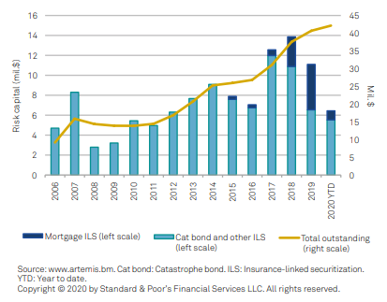
Cat Bonds & ILS
Source: S&P Global reinsurance Report 2020
Notes:
Source: S&P Global reinsurance Report 2020

Slide 32
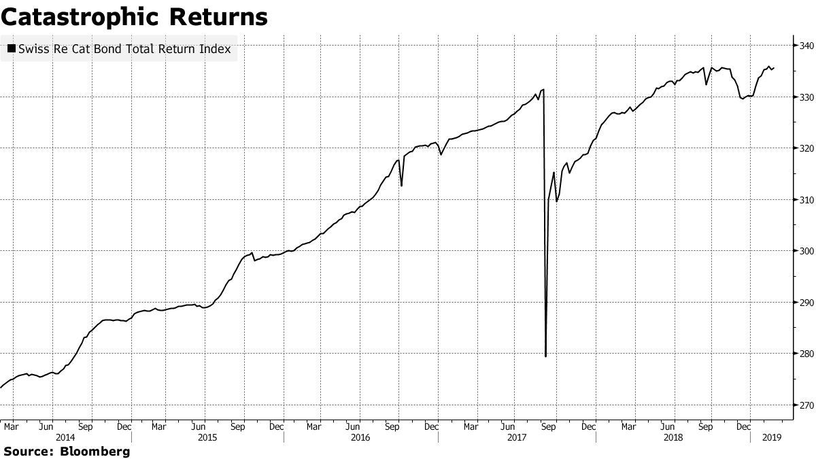
Cat Bond Returns
Source Bloomberg 27 Feb 19
Notes:
Source Bloomberg 27 Feb 19 https://www.bloomberg.com/news/articles/2019-02-26/first-terror-bond-sale-opens-new-high-yield-catastrophe-market

Slide 33
Summary
Reinsurance definition
ILS (insurance Linked Securities)
Cat Bond

Slide 34
Test Your Understanding
Imagine that HKSAR Government issues a Cat Bond linked to a severe earthquake. What will happen to investors if the earthquake takes place (meeting the criteria of the bonds)
Investors will get the coupons and principal
Investors will get the principal
Investors will lose the principal

Slide 35
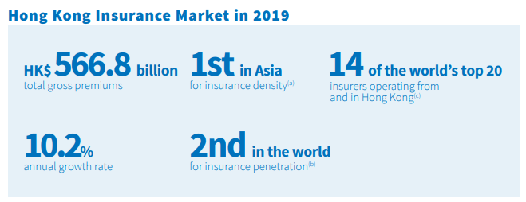
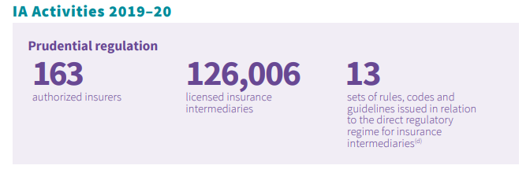
Insurance in HK
Source: IA report 2019
Notes:
Source: IA annual report 2019-2020 https://www.ia.org.hk/en/infocenter/files/IA_Annual_Report_2019_20_Eng.pdf

Slide 36
Insurance in HK: from self regulated to the IA
“In respect of the insurance regulatory structure, we are setting up an Insurance Authority that is not part of the government, as mandated in ICP 2.
We are also abolishing our current self-regulatory system for intermediaries to strengthen the conduct regulatory regime.
We are establishing a Policyholders’ Protection Fund to provide another safety net for policyholders.
We issued new requirements on underwriting unit-linked policies, following the cradle-to-grave approach adopted in ICP19 on Fair Treatment of Customers.
We also introduced a new intermediaries’ remuneration disclosure system to enhance transparency.
Together with the banking and securities regulators, we have enacted a new legislation on anti-money laundering and are working on a resolution regime for financial institutions.
Just two days ago, we issued a consultation paper on a risk-based capital framework for Hong Kong.” Annie Choi, CI, 18 Sept 14 at the FT Insurance Summit in Hong Kong
Notes:
Source: http://www.oci.gov.hk/download/sp_20140918.pdf

Slide 37
Regulation: Independent Insurance Authority (IA) in Hong Kong
The IA, a statutory body established by the Insurance Companies (Amendment) Ordinance 2015 (Amendment Ordinance), is a new insurance regulator independent of the Government.
Since end of 2016 the IA has replaced the OCI and has taken over the regulation of insurance intermediaries from the three Self-Regulatory Organisations (SROs) through a statutory licensing regime. The IA has fully taken over the supervision of insurance intermediaries from the SROs.
Notes:
Source: http://www.info.gov.hk/gia/general/201512/28/P201512280307.htm

Slide 38
Organisation structure of the IA

Slide 39
Current issues in Insurance
Growth of insurance in Asia
The rise of InsurTech
Automation
Digitization
Virtual Insurance
Increased competition from China (Zhong An, Ping An…)
IFRS 17 and other accounting changes
Solvency II and regulatory changes

Slide 40
Summary
Insurance regulation in HK

Slide 41
Current issues in Insurance
Insurance in Asia: what is the penetration level of insurance in Asia? Compare to Europe and US - why the differences? Implications? (Group 13)
Video
https://www.peak-re.com/insights/increasing-insurance-penetration-in-asia/
Article
https://www.asiainsurancereview.com/Magazine/ReadMagazineArticle?aid=40294

Slide 42
Course Map
Overview
Financial Institutions
Sell Side
Buy Side
Insurance Companies
Pension Funds and Retirement Schemes
Mutual Funds and Fund Management
Commercial Banking
Traditional Institutional Investors
Investment Banking

Slide 43
Pensions and Retirement Funds
Definition
Public pensions: social security and mandatory retirement plans
Private pensions: 401K and IRAs
Regulation
Pensions & retirement funds in Asia
Current issues

Slide 44
Multi-pillar retirement system
In 1994, the World Bank recommended a three-pillar framework to address the issue of old-age protection; this was expanded to a five-pillar framework In 2005 based on operational experience:
Pillar 0: a non-contributory, publicly financed and managed system that provides a minimal level of protection for retirement;
Pillar 1: a mandatory, contributory and publicly managed system
Pillar 2: a mandatory, privately managed, fully funded contribution system;
Pillar 3: voluntary savings (e.g. personal savings and insurance); and
Pillar 4: informal support (e.g. family support), other formal social programmes (e.g. health care and housing) and other individual assets (e.g. home ownership).
public
private
44

Slide 45
The retirement resource pyramid (US)
Source: Investment Company Factbook 2019
Notes:
Source: ICI Factbook 2019 Retirement Resource Pyramid
The retirement resource pyramid has five layers, which draw from government programs, compensation deferred until retirement, and other savings and assets (Figure 7.1):
Social Security
homeownership
employer-sponsored retirement plans (private-sector and government employer plans, including both defined benefit [DB] and defined contribution [DC] plans)
individual retirement accounts (IRAs), including rollovers
other assets
While the importance of each layer differs by household, together they have enabled recent generations of retirees, on average, to maintain their standard of living in retirement.
The construction of each household’s pyramid varies with age and income. Younger households are more likely to save primarily for reasons other than retirement, such as a home purchase, family needs, or education (Figure 7.2). By contrast, older households are more likely to save primarily for retirement, as many already have reached their other savings goals. The tendency of younger workers to focus less on saving for retirement is consistent with economic models of life-cycle consumption predicting that most workers delay saving for retirement until later in their careers. Lower-income households also focus less on saving for retirement, reflecting the fact that Social Security benefits replace a higher share of pre-retirement earnings for workers with lower lifetime earnings.
Social Security, the base of the U.S. retirement resource pyramid, is the largest component of retiree income and the primary source of income for lower-income retirees. Social Security benefits are funded through a payroll tax equal to 12.4 percent of earnings of covered workers (6.2 percent paid by employees and 6.2 percent paid by employers) up to a maximum taxable earnings amount ($117,000 in 2014). The benefit formula is highly progressive, with benefits representing a much higher percentage of earnings for workers with lower lifetime earnings. By design, Social Security is the primary means of support for retirees with low lifetime earnings and a substantial source of income for all retired workers. For individuals born in the 1950s, the Congressional Budget Office (CBO) projects that mean first-year Social Security benefits will replace 85 percent of average inflation-indexed lifetime earnings for the bottom 20 percent of retired workers ranked by lifetime household earnings (Figure 7.3). The mean replacement rate drops to 64 percent for the second quintile of households, and then declines more slowly as lifetime household earnings increase. For even the top 20 percent of lifetime earners, Social Security benefits are projected to replace a considerable portion (34 percent) of earnings.
For many near-retiree households, homeownership is the second most important retirement resource after Social Security. Older households are more likely to own their homes; more likely to own their homes without mortgage debt; and, if they still have mortgages, more likely to have small mortgages relative to the value of their homes. Retired households typically access this resource simply by living in their homes rent-free.
Employer-sponsored retirement plans and IRAs, which complement Social Security benefits and are important resources for households regardless of income or wealth, increase in importance for households for whom Social Security replaces a smaller share of earnings. In 2013, about eight out of 10 near-retiree households had accrued benefits in employer-sponsored retirement plans—DB and DC plans sponsored by private-sector and government employers— or IRAs

Slide 46
Total US Retirement Market Assets 1995-2019, Trillions of $, year-end
Source: Investment Company Factbook 2020

Slide 47
Pensions in the US
Definition: A pension plan is an asset pool that accumulates over an individual’s working years and is paid out during the nonworking years
Developed as Americans began relying less on children for care during their later years
Also became popular as life expectancy increased
Source: Mishkin/Eakins
Notes:
Source: http://www2.iii.org/financial-services-fact-book/retirement-assets/retirement-funds-iras-and-401ks.html
68 percent of all U.S. households had retirement plans through work or individual retirement accounts (IRAs) in 2009.
In 2009 nearly two-thirds of retirement assets (64.8 percent) were in an employer-sponsored retirement plan (including government and private plans). About one-quarter (26.4 percent) of such assets were in individual retirement accounts and 8.8 percent were in annuities.

Slide 48
Defined Benefit vs. Defined Contribution Pension Funds
Defined-Benefit Pension Plans:
Defined-Contribution Pension Plan:
A plan where the sponsor promises the employee a specific benefit when they retire
E.g. Annual Retirement Payment = 2% × average of final 3 years’ income × years of service
A plan where a set amount is invested for retirement, but the benefit payout is uncertain
Defined-Benefit Pension Plans place a burden on the employer to properly fund the expected retirement benefit payouts.
Fully funded: sufficient funds are available to meet payouts
Overfunded: funds exceed the expected payout
Underfunded: funds are not expected to meet the required benefit payouts
Notes:
Types of Retirement Plans
(Source: http://www.iii.org/financial2/asset/assets/)
There are two basic types of pension funds: Defined benefit and defined contribution plans.
In a defined benefit plan, the income the employee receives in retirement is guaranteed, based on predetermined benefits formulas. Typically, benefits are based on a percentage of the participant’s “terminal earnings,” i.e., earnings at retirement.
In a defined contribution plan, a type of savings plan in which taxes on earnings are deferred until funds are withdrawn, the amount of retirement income depends on the contributions made and the earnings generated by the securities purchased. The employer generally matches the employee contribution up to a certain level and the employee selects investments from among the options the employer’s plan offers. 401(k) plans fall into this category, as do 403(b) plans for nonprofit organizations.
Other types of retirement funds include profit sharing plans, in which employers contribute to accounts based on their profits, and Keogh plans for the self-employed and employees of small businesses. Some workers who do not fall into these categories may make limited contributions to an individual retirement account (IRA). IRAs allow individuals to save money without paying taxes until they withdraw it. With the Roth IRA, a plan created in 1998 for individuals earning below specified income levels, individuals pay taxes on the money before it is saved and withdraw funds without paying federal taxes. Beginning in 2010 people with traditional IRAs will be able to convert them to Roths. Roth 401(k)s were introduced in 2001 and made permanent by federal law in 2007

Slide 49
Defined Contribution Plan Assets by Type of Plan Trillions of $, year-end, 1995-2018
Source: Investment Company Factbook 2019

Slide 50
US - Public Pension Funds
Any pension plan set up or sponsored by a government body; funds administered by a federal, state, or local government
2 types:
State or local government pension funds
set up for state or local government employees
funded on a “pay as you go” basis
state and local pension funds held most of their assets in corporate equities (58.13% in 2004)
Federal government pension funds - two types
federal government employees, civil service employees, military and railroad employees not covered by The Federal Old Age and Disability Insurance Program (“Social Security”)
Social Security
funded on a “pay as you go” basis
Projected number of workers is falling while projected number of retirees is increasing, which will cause problems in years to come if not corrected
Social security contributions are invested in relatively low-risk, low-return Treasury securities
“Pay as you go” means that money that workers contribute today pays benefits to current recipients. Future generations will be called on to pay benefits to current contributors.
Notes:
“Pay as you go” basis, where current funding is used (partially) to pay current benefits
Solutions to SS problems: increase retirement age (from 65 to 67 for example: measure passed in mid 90s), increase contributions (from 6.2% in 98 to 7.65% in 05); public funding to supplement resources; diversification of assets to higher yielding instruments (e.g. alternative investments)
Definition of 'Pay As You Go Pension Plan'
A retirement scheme where the plan beneficiaries decide how much they want to contribute either by having the specified amount regularly deducted from their paycheck or by contributing the desired amount in a lump sum. A pay as you go pension plan is similar to a 401k. The employee can choose among the various investment options and decide on whether they want a higher return by investing in a more risky fund or a safer fund which provides steady returns Read more: http://www.investopedia.com/terms/p/pay-as-you-go-pension-plan.asp#ixzz1oxoh0ZoI
Investopedia explains 'Pay As You Go Pension Plan'
When retirement age comes along, the beneficiary can choose to either receive the benefits in a lump sum or as a lifetime annuity where the benefits are spread in monthly payments throughout the beneficiary's lifetime. This is different from a fully funded pension where the company fully funds, manages and distributes the benefits at retirement. Read more: http://www.investopedia.com/terms/p/pay-as-you-go-pension-plan.asp#ixzz1oxorlLvb
DEFINITION of 'Social Security‘: http://www.investopedia.com/terms/s/socialsecurity.asp#ixzz3XMaNjJar
A United States federal program of social insurance and benefits developed in 1935. The Social Security program's benefits include retirement income, disability income, Medicare and Medicaid, and death and survivorship benefits. Social Security is one of the largest government programs in the world, paying out hundreds of billions of dollars per year.
Based on the year someone was born, retirement benefits may begin as early as age 62 and as late as age 67. The amount of income received is based on the average wages earned over the worker's lifetime, with a maximum calculable amount of $102,000 as of 2008. Spouses are also eligible to receive Social Security benefits, even if they have limited or non-existent work histories.
The original program was part of President Franklin D. Roosevelt's New Deal plan to lift the U.S. out of the Great Depression. Today, the program is funded through payroll taxes collected by employees and companies; monies are placed into the Social Security Trust Fund and payments are managed by the government along with the Federal Reserve Board.
Social Security has faced serious solvency issues for many decades; today's payments are made from current payroll contributions by workers who may not have money available for them when they retire. Social security reform, whether through legislation, tax law changes, or privatization, has been a major political issue that draws strong opinions from different demographic segments.
Social Security faces the real threat of becoming insolvent because of factors such as longer life expectancies, a large baby boomer population currently entering retirement age, and inflation.

Slide 51
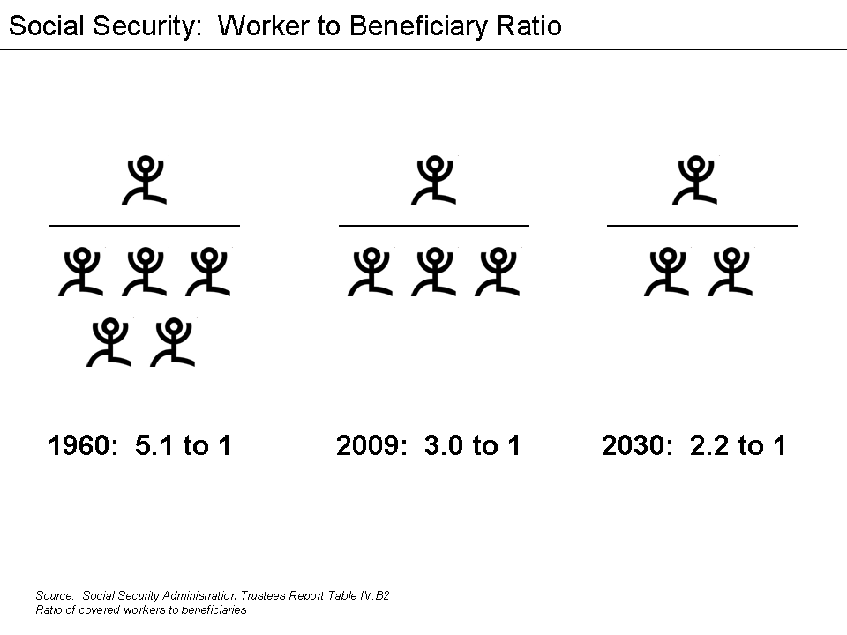
Social security in the US
Notes:
Source: Wikipedia http://upload.wikimedia.org/wikipedia/en/e/e1/Social_Security_Worker_to_Beneficiary_Ratio.png

Slide 52
US - Private pension funds; types of retirement plans
Any pension plan set up by employers, groups, or individuals; funds administered by a private corporation (e.g., insurance company, mutual fund)
Increasingly dominated by defined contribution plans
Types of private pension plans
401(k) and 403(b): employer sponsored plans that supplement a firm’s basic retirement plan
individual retirement accounts (IRA’s) and Roth IRAs
Keogh accounts (for self employed and SME employees)
Notes:
401(k) and 403(b): employer sponsored plans that supplement a firm’s basic retirement plan, allowing for both employee and employer contributions. 401(k) plans are offered to employees of taxable firms while 403(b) plans are for employees of certain tax-exempt employers (e.g. hospitals and educational institutions). Contributions to these plans are taken on a pretax basis and thus reduce the employee’s taxable salary. Both the contributions and earnings then grow tax deferred until they are withdrawn. Most of these plans are movable to another 401(k) or 403(b) or an IRA if the employee changes jobs. Participants in 401(k) and 403(b) generally make their own choice of the allocation of assets from both employee and employer contributions
The IRA is a tax-deductible savings plan for those who are self-employed, or whose earnings are below a certain level or whose employers do not offer retirement plans. They are self-directed retirement accounts set up by employees who may also be covered by employer-sponsored pension plans as well as self-employed individuals. Contributions to the IRA are made strictly by the employee. IRAs were first allowed in 1981 as a method of creating a tax-deferred retirement account to supplement an employer-sponsored plan. As of 2004 a maximum of US$4,000- may be contributed to an IRA per year; non-working couples can contribute an additional $4,000- if couple’s adjusted gross income is less than $150,000- and neither is covered by an employer-sponsored plan. IRAs may also be used by employees changing jobs: any funds held by an employee in the old employer’s pension fund may be invested in a tax-qualified IRA to maintain the tax deferred status.
Other types of retirement funds include profit-sharing and Keogh plans for the self-employed and employees of small businesses. Some people not in those categories may make limited IRA contributions on a tax-deferred basis. The Roth IRA, a special kind of retirement account created in 1997, may offer greater tax benefits to certain individuals. Unlike a regular IRA, the Roth IRA contributions are taxed in the year of contribution and withdrawals are tax free (as long as account holder is at least 59 ½ and funds have been invested >5Y).
An increasing number of retirement plans give participants the option of opening up an account with a brokerage firm of their choice through the plan. These self directed accounts can afford access to a wide variety of investment options. Most IRA contributions are invested in mutual funds purchased through brokers or a mutual fund company.
Keogh account is a retirement account available to self-employed individuals. Contributions may be deposited in a tax-deferred account administered by a life insurance company, bank of other FIs. As with 401(k), participants are given some discretion as to how the funds are to be invested.
2 types of Keogh accounts are
Profit sharing Keogh: contributions can vary by year
Money sharing plans require a mandatory contribution at a constant % of the employee’s income per year whether the individual has profits or not
Major advantage of Keogh plans is high level of max contributions: money sharing plans: the lesser of $41,000- or 25% of self-employment income; profit-sharing up to $41K and 20% of income.
Types of Retirement Plans
There are two basic types of pension funds: defined benefit and defined contribution plans.
In a defined benefit plan, the income the employee receives in retirement is guaranteed, based on predetermined benefits formulas. Typically, benefits are based on a percentage of the participant’s “terminal earnings,” i.e., earnings at retirement. Several other options have also been developed.
In a defined contribution plan, a type of savings plan in which taxes on earnings are deferred until funds are withdrawn, the amount of retirement income depends on the contributions made and the earnings generated by the securities purchased. The employer generally matches the employee contribution up to a certain level and the employee selects investments from among the options the employer’s plan offers. 401(k) plans fall into this category, as do 403(b) plans for nonprofit organizations. Other types of retirement funds include profit sharing plans, in which employers contribute to accounts based on their profits, and Keogh plans for the self-employed and employees of small businesses. Some workers who do not fall into these categories may make limited contributions to an individual retirement account (IRA). IRAs allow individuals to save money without paying taxes until they withdraw it. With Roth IRAs, a plan created in 1998 for individuals earning below specified income levels, individuals pay taxes on the money before it is saved and withdraw funds without paying federal taxes. Beginning in 2010 people with traditional IRAs will be able to convert them to Roths. Roth 401(k)s were introduced in 2001 and made permanent by federal law in 2007. Unlike traditional 401(k) plans, Roth 401(k)s are funded with after tax dollars.

Slide 53
IRA assets
Source: Investment Company Factbook 2020

Slide 54
US households have other retirement assets besides Social Security (% of households, 2019)
Notes:
Source: ICI Factbook 2020

Slide 55
Summary
Multi-pillar retirement system and the retirement pyramid
Pensions & retirement Plans in the US
Defined-benefit v. defined contribution
Public v private pension fund
Social Security
Types of private retirement plans in the US

Slide 56
Test Your Understanding
Demographic trends and changes in retirement patterns suggest that Social Security funding problems will ease over the next few decades.
TRUE / FALSE
In the US, Social Security is a ________
fully funded pension plan.
federally insured private pension plan.
government sponsored private pension plan.
“pay-as-you-go” system.

Slide 57
US Regulation of Pension Plans
1949 U.S. Supreme Court decision → pension benefits are a legitimate part of collective bargaining
The number of plans increased from this as unions negotiated for such plans
Employee Retirement Income Security Act of 1974 (ERISA)
Does NOT mandate that employers establish pension funds for their employees
Established guidelines for funding: contributions to pension funds must be sufficient to cover all annual costs & expenses and to fund any unfunded historical liabilities over a 30 year period; any new underfunding arising from low investment returns have to be funded over a 15 year period.
Allowed plan credit to transfer with employees
Established vesting requirements to gain plan benefits
Increased disclosure requirements
Assigned regulatory oversight to the Department of Labor
Source: Mishkin/Eakins
Notes:
Prior to ERISA there were no statutory requirement forcing defined benefits fund administrators to adequately fund their pension funds.

Slide 58
US Regulation of Pension Plans
ERISA also established the Pension Benefit Guarantee Corporation to insure pension benefits if an underfunded pension plan is unable to meet its obligations.
Accounting makes it difficult to assess funding status of a plan
May be in trouble as plans appear underfunded
Pension reform Act of 1978 authorized individual retirement accounts (IRAs)
Enjoy a preferential tax treatment
Keogh plans are similar plans for self-employed individuals
SIMPLE IRAs are simplified retirement plans for small businesses.

Slide 59
The Pension Protection Act 2006
2006 Pension Protection Act signed 17 August 2006
Strengthens the federal pension insurance system
Allows companies to phase out their Traditional Defined Benefit or other pension plan and automatically enroll employees in 401(k) plans, as well as set investment guidelines
makes tax breaks for retirement plans and accounts which were scheduled to expire in 2010 permanent
gives taxpayers the option of direct depositing portions of their tax refunds into IRAs
permits 401(k) and similar plans to offer investment advice
Gives employers seven years to fully fund their plans (some airlines in bankruptcy proceedings got 10 years)
Notes:
In 2006 Congress passed the Pension Protection Act, landmark pension reform legislation enacted to close shortfalls in employers’ funding of defined benefit pension plans. The act gave employers seven years to fully fund their plans but gave some airlines in bankruptcy proceedings an extra 10 years to meet their obligations.
The Pension Protection Act of 2006 makes it easier for workers to start and contribute to a retirement savings plan in these ways:
Encouraging employers to enroll workers automatically in 401(k) or 403(b) savings plans. It's estimated that at least 12 million workers eligible for such plans haven't signed up. Until now, workers have had to proactively start retirement plans; now more will have to go out of their way to opt out of one. The law allows employers to earmark 3 percent of a worker's salary into a 401(k) and as much as 6 percent over time to help workers save more.
Giving taxpayers the option of depositing portions of their federal tax refund directly into an IRA. "It's really a painless way to make a contribution to an IRA," says Sallie Olson, a CPA and retirement plan specialist with Aldrich Kilbride & Tatone of Portland, Ore.
Permitting 401(k) and other similar plan providers to offer face-to-face, personally tailored investment advice to help workers manage their retirement savings plans. The goal is to ease anxiety for workers not used to making investment decisions. The law takes several steps to prevent adviser conflicts-of-interest.
As a result of the new law, several retirement savings incentives - originally passed by Congress in 2001 but set to disappear after 2010 - now become permanent. Retirement specialists expect the changes to make long-range retirement planning more predictable and provide older workers enhanced options to beef up their nest eggs. These changes include the following:
Allowing workers in employer-sponsored 401(k), 403(b) and other similar plans to put up to $15,000 this year in pretax income in 2006, and higher amounts each year - based on inflation - beginning in 2007. Individuals with a regular IRA or Roth IRA - plans funded with after-tax money allowed to grow tax-free - can contribute up to $4,000 in 2006 and 2007, $5,000 in 2008, and even more in later years to reflect inflation. If you are 50 or older, you may increase these amounts by $1,000 each year.
Continuing to let workers 50 and older in 401(k) and similar retirement plans sock away, on a tax-deferred basis, an additional $5,000 this year and more in following years, based on inflation. That's $20,000 that an older worker can set aside pre-tax for retirement. "This especially helps those who have finally finished paying for college," says Alice Orzechowski, a Frederick, Md., CPA. "They now have a few years to beef up their own retirement accounts."
Making permanent the so-called Saver's Credit - which would have disappeared after Dec. 31 - which provides up to a 50 percent tax credit for low- and moderate-income families that contribute up to $2,000 a year to a retirement plan. "The Saver's Credit, if you ask me, is the equivalent of a government match" to your retirement savings, Yeager says. "Credits are much better than deductions; that's money in your pocket."
Increasing the ease of transferring money between plans, including portability of after-tax contributions. For example, starting in 2008 it becomes easier to roll money from an IRA to a Roth IRA, and the new law gives employers enhanced options to offer Roth 401(k) retirement plans.
Changes for Giving, Saving, Planning
The reform law also contains several nonretirement changes.
Donating to charities: "The law dramatically changes certain rules," Orzechowski says. "No deduction is allowed for cash, check or other monetary donations unless the taxpayer has a bank record or written acknowledgement from the charity." No deduction either for clothing and household donations, unless they are in "good" condition, a term Congress did not define. A good change: Those 70½ and older in 2006 and 2007 can make tax-free distributions from their IRA directly to a charity. "This new rule benefits taxpayers who do not itemize, as well as those who would be adversely affected by the normal restrictions and limitations on charitable contributions," Orzechowski adds.
Saving for college: The law permanently extends the rules and tax benefits of the Section 529 college-savings plans popular with those saving for their children's and grandkids' educations.
Planning for long-term care: Beginning in 2010, the law allows individuals who have built up cash value in an annuity or life insurance policy to buy long-term-care insurance coverage without declaring the premium payments from the policy as income for tax purposes, and receive long-term-care benefits tax-free.
The Pension Protection Act Strengthens The Federal Pension Insurance System. The legislation:
Requires companies that under-fund their pension plans to pay additional premiums;
Extends a requirement that companies that terminate their pensions provide extra funding for the pension insurance system;
Requires that companies measure the obligations of their pension plans more accurately;
Closes loopholes that allow under-funded plans to skip pension payments;
Raises caps on the amount that employers can put into their pension plans, so they can add more money during good times and build a cushion that can keep their pensions solvent in lean times; and
Prevents companies with under-funded pension plans from digging the hole deeper by promising extra benefits to their workers without paying for those promises up front.
President Bush Has Sent A Clear Message To Businesses Across America That They Must Keep Their Promises To Workers. Businesses that offer a private pension plan to their employees have a duty to set aside enough money now, so their workers get what they have been promised when they retire.
The Pension Protection Act Also Contains Provisions To Help American Workers Who Save For Retirement Through Defined Contribution Plans, Like IRAs And 401(k)s. Defined contribution plans are helping Americans build a society of ownership and financial independence, and this legislation makes it easier for workers to participate in these plans. The legislation:
Removes barriers that prevent companies from automatically enrolling their employees in defined contribution plans;
Ensures that workers have more information about the performance of their accounts;
Provides greater access to professional advice about investing for retirement;
Gives workers greater control over how their accounts are invested; and
Makes permanent the higher contribution limits for IRAs and 401(k)s that were passed in 2001, enabling more workers to build larger retirement nest eggs.

Slide 60
Retirement product convergence: Annuities
There are several types of annuities: deferred/immediate and fixed/variable
Annuities are typically sold by insurance companies

Slide 61
Summary
US regulation of pension plans:
Regulator
ERISA
Pension Reform Act 1978
Pension Protection Act 2006

Slide 62
Test Your Understanding
which government entity regulates the pension sector in the US?
The Fed
The SEC
The Department of Labor
If a private pension plan fails in the US, what happens to workers pensions?
They lose all their pensions
Pension liabilities are taken over by the PBGC
Pension liabilities are taken over by the Fed

Slide 63
Pension Funds in HK: the Mandatory Provident Fund
Established 1 December 2000. Privately managed, employment related scheme.
Regulation: MPFS Ordinance August 1995. Regulator: MPFSA (Mandatory Provident Fund Schemes Authority) set up in September 1998
Mandatory:
Employees (> 60 days continued employment) have to contribute 5% of their wages to the MPF; contributions are matched by employer (total 10%)
Members choice:
Means employee can choose where contributions are invested, within the array of choices available under the plan
Contributions not available until retirement age (65)
Portable plan:
When changing jobs, employee can transfer to new employer plan or to own MPF
Trustee set-up:
MPF funds must be in a trust structure to ensure maximum protection of scheme members’ assets
Notes:
Source: http://www.mpfa.org.hk/english/abt_mpfs/abt_mpfs_bgd/abt_mpfs_bgd.html
In August 1995, Hong Kong took a major step in enacting the Mandatory Provident Fund Schemes Ordinance to provide a formal system of retirement protection. The ordinance provides the framework for the establishment of a system of privately managed, employment-related MPF schemes to accrue financial benefits for members of the workforce when they retire.
The Mandatory Provident Fund Schemes Authority (MPFA) was established in September 1998 to regulate, supervise and monitor the operation of the MPF System. The MPF System came into operation on December 1, 2000.
The 15-year-old MPF System has grown alongside Hong Kong, and has contributed significantly to building up the retirement savings of the people of Hong Kong. At present, around 85% of Hong Kong
workers are covered by the MPF System, or by some other forms of retirement scheme. By international standards, this level of coverage is excellent. As at the end of October 2015, the total assets of the
MPF System amounted to almost $600 billion. This means the annualized rate of return from the inception of the MPF System to October 2015 was 3.4%, higher than the 1.8% inflation rate over the same period.

Slide 64
Pensions in HK: Regulatory Structure
Before the MPF System was launched (in 2000), retirement schemes set up voluntarily by employers for their employees were regulated under the Occupational Retirement Schemes Ordinance (ORSO).
Government of Hong Kong
MPF Schemes Authority
MPF Schemes
Occupational Retirement Schemes
MPF Trustees
MPF Intermediaries (in coordination with HKMA, Insurance Authority and Securities and Futures Commission)
MPF Schemes and Products (in coordination with Securities and Futures Commission)
The MPFA is now responsible for regulating both MPF schemes and ORSO schemes, under the MPFSO and the ORSO respectively
Notes:
Source: http://www.mpfa.org.hk/english/abt_mpfa/abt_mpfa_rs/abt_mpfa_rs.html
Before the MPF System was launched (in 2000), retirement schemes set up voluntarily by employers for their employees were regulated under the Occupational Retirement Schemes Ordinance (ORSO). These ORSO schemes were exempted from MPF requirements as long as they met certain conditions, but the MPFA is now responsible for regulating both MPF schemes and ORSO schemes, under the MPFSO and the ORSO respectively. This regulatory work is carried out on the basis of the relevant legislation, as well as guidelines and codes covering these schemes, under the regulatory structure shown here

Slide 65
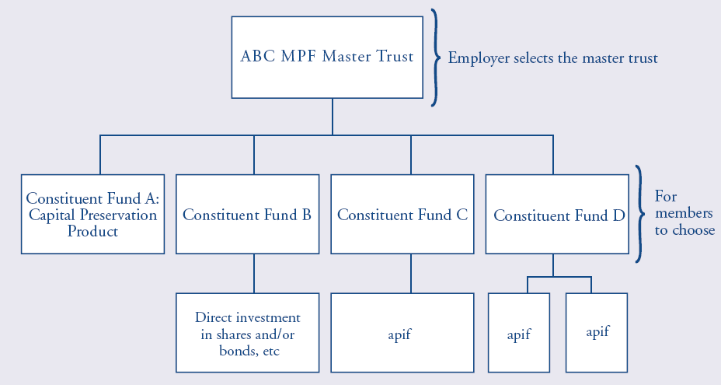
MPF Structure: Constituent Funds
approved pooled investment funds (“apif”) can be a unit trust or an insurance policy
Source: http://www.hkifa.org.hk/eng/download/fundinfo/mpf/HKIFA_Edu_E.pdf
Notes:
Member choice means that employees (who are members of an MPF scheme) can have the right to choose MPF constituent funds. However, member choice is limited to the choice offered by the master trust(s) chosen by the employer.
Employees choose constituent fund(s). A constituent fund invests in one or more approved pooled investment funds (“apif”) or invests directly. An apif can be a unit trust or an insurance policy.

Slide 66
Employee Choice Arrangement
The Employee Choice Arrangement (ECA) started on 1 November, 2012. From that date, employees are allowed to transfer their accrued benefits, i.e. the accumulated contributions and investment returns, which arise from the employee mandatory contributions made during their current employment to another MPF trustee and scheme of their own choice once every calendar year; or not to make any change by retaining the accrued benefits in the MPF scheme they are currently enrolled in.
In addition, the minimum and maximum levels of relevant income have been adjusted to HKD 7,100 and HKD 30,000 respectively (as of October 2014)
Notes:
http://www.mpfa.org.hk/english/quicklinks/quicklinks_eca/eca.html
http://www.mpfa.org.hk/english/quicklinks/quicklinks_ri/quicklinks_minmax.html
http://www.mpfa.org.hk/eng/mpf_system/system_features/contributions/index.jsp

Slide 67
Withdrawal choice arrangement
Introduction of choice of withdrawal by installments instead of lump sum (effective 1 Feb 16) : Scheme members who have reached the age of 65, or who have reached the age of 60 and have decided to early retire can choose to either :
withdraw their MPF benefits by installments or
withdraw all their MPF benefits in a lump sum, or
retain all their MPF benefits in their accounts for continuous investment.

Slide 68
Default Investment Strategy
To address the problems of high fees and difficulty in making choices associated with some MPF schemes, the Government and the MPFA propose to require each trustee to provide, in each scheme, a Default Investment Strategy (DIS). The Government introduced the amendment bill to the Legislative Council on 25 November 2015, and the was launched by the end of 2016.
MPF members who don’t select any options will by default contribute into the DIS.
Notes:
Source: MPFA http://www.mpfa.org.hk/eng/information_centre/publications/mpfa_newsletter/files/Newsletter_21.pdf

Slide 69
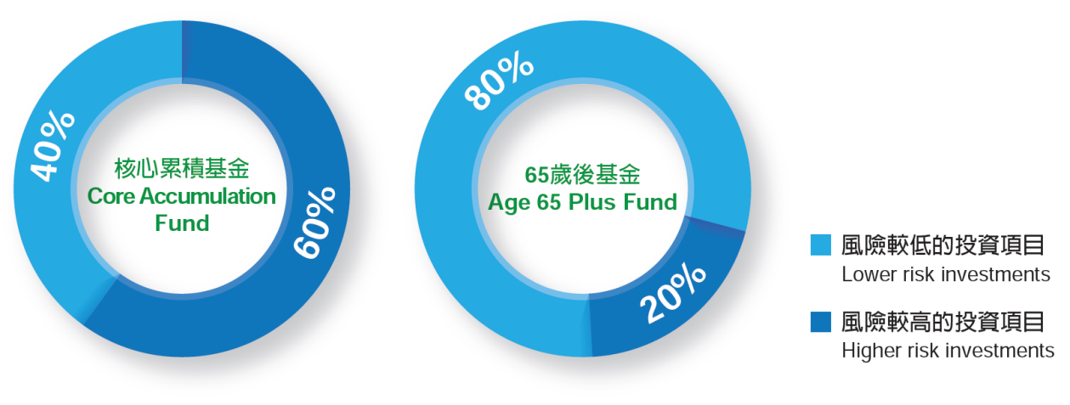
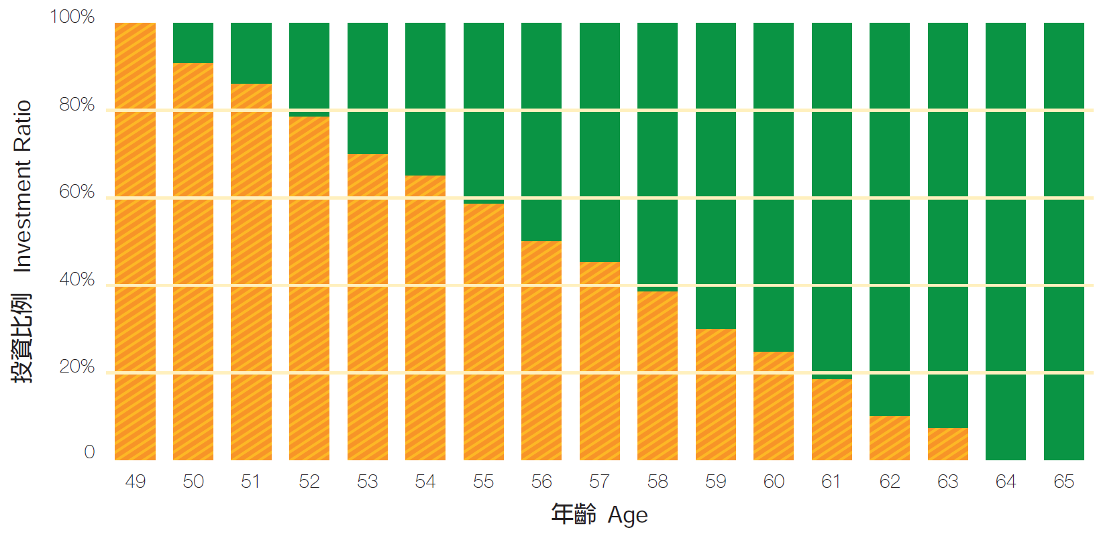
Default Investment Strategy
2 globally diversified funds : Core accumulation Fund and Age 65 Plus Fund
Principle of age de-risking:
<50: 100% invested in the Core Accumulation Fund.
50-64: MPF benefits in the Core Accumulation Fund gradually switched to the Age 65 Plus Fund every year, so that the ratio of higher risk investments in the investment portfolio will fall by around 2.6% every year.
65+: all MPF benefits will be invested in the Age 65 Plus Fund.
Fee controls: management fees capped at 0.75% p.a.
Notes:
In short, the DIS is a highly standardized and fee-controlled MPF investment strategy designed to be consistent with the objective of building up long-term retirement savings. If scheme members do not make any choices for their MPF investments, their MPF contributions will be invested according to the DIS of their respective scheme. Scheme members can also choose to opt for the DIS
The key features of the DIS are described below:
Made up of two constituent funds (“CFs”)
To balance potential risks and returns, the DIS will be made up of two mixed asset CFs, namely the Core Accumulation Fund and the Age 65 Plus Fund. The CFs will invest in a globally diversified manner. The Core Accumulation Fund will adopt a more aggressive investment strategy and invest more in higher risk investments (e.g. global equities), while the Age 65 Plus Fund will adopt a more conservative investment strategy and mainly invest in lower risk investments (e.g. global bonds). The investment ratios of these two CFs are shown in the diagram below:
Investment principles:
1) Age-based de-risking
As the scheme member approaches retirement age, the investment strategies will be adjusted by reducing the investment in higher risk assets accordingly:
Aged below 50: all MPF benefits will be invested in the Core Accumulation Fund.
Aged 50 to 64: MPF benefits in the Core Accumulation Fund will be gradually switched to the Age 65 Plus Fund every year, so that the ratio of higher risk investments in the investment portfolio will fall by around 2.6% every year.
Aged 65: all MPF benefits will be invested in the Age 65 Plus Fund.
2) Globally diversified
Investment markets are often affected by factors such as the geopolitical and economic situations in different countries. To diversify risk, the CFs will invest in both local and overseas markets in a diversified manner.
Fee controls
Management fees must not exceed an annual rate of 0.75% of the net asset value of the CFs and this figure of 0.75% is just a starting point.
Fees covered within the fee cap include all fees for services provided by trustees, administrators, investment managers, custodians, sponsors and promoters, as well as similar fees chargeable to the underlying investment funds.

Slide 70
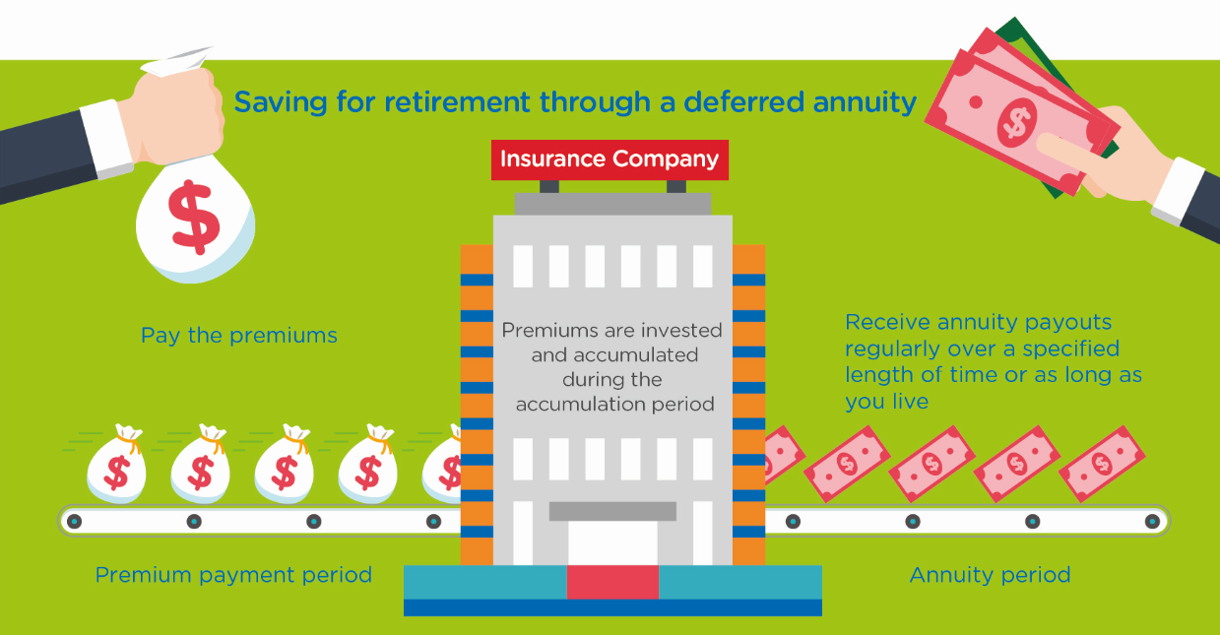
Launch of Tax Deductions for Annuity Premiums and MPF Voluntary Contributions
The amendment ordinance (2019) provides tax deductions for qualifying deferred annuity premiums (QDAP) and tax deductible MPF voluntary contributions (TVC) under salaries tax and personal assessment.
The deduction cap is $60,000 per year, which is an aggregate limit for both qualifying deferred annuity premiums and TVC
Notes:
Source: HK Government https://www.gov.hk/en/residents/taxes/salaries/allowances/deductions/annuity.htm and https://www.ifec.org.hk/web/en/moneyessentials/qdap-tvc/what-is-qdap.page#lightbox

Slide 71
Qualifying Deferred Annuity Policy (“QDAP”)
For relevant premiums to qualify for tax deductions, a deferred annuity product must comply with the guideline issued by the Insurance Authority, including:
Minimum total premiums of $180,000 and minimum payment period of 5 years
Minimum annuity period of 10 years
Annuitization at the age of 50 or beyond
Disclosure of the internal rate of return of the product to facilitate evaluation and comparison
Clear presentation of the guaranteed and non-guaranteed annuity payouts
Clear separation of premiums of all riders (e.g. critical illness, hospitalisation cash, etc.) from the qualifying deferred annuity premiums
Notes:
Source: https://www.ifec.org.hk/web/en/moneyessentials/qdap-tvc/what-is-qdap.page

Slide 72
Summary
HK’s Mandatory Provident Fund
Characteristics
regulatory structure
constituent funds
ECA
DIS
WCA
tax deductions
QDAP

Slide 73
Test Your Understanding
The MPF is a
Defined benefits plan
Defined contributions plan
Under the Employee Choice Arrangement (ECA), employees can:
Change their allocation choices within the employer plan
Transfer their contributions to another MPF plan of their choice
Transfer both their employers and their own contributions to another MPF plan
The Withdrawal Choice Arrangement allows employees to
Take their contributions in cash at any time
At retirement, choose to get a lump sum or an annuity or keep the money in the MPF longer

Slide 74
Current issues: MPF
MPF in HK: what are the issues? What are the possible solutions?(Group 15)
Video
http://cdhkdata.chinadailyhk.com/retirement-system-upgraded
Article
http://cdhkdata.chinadailyhk.com/retirement-system-upgraded

Slide 75
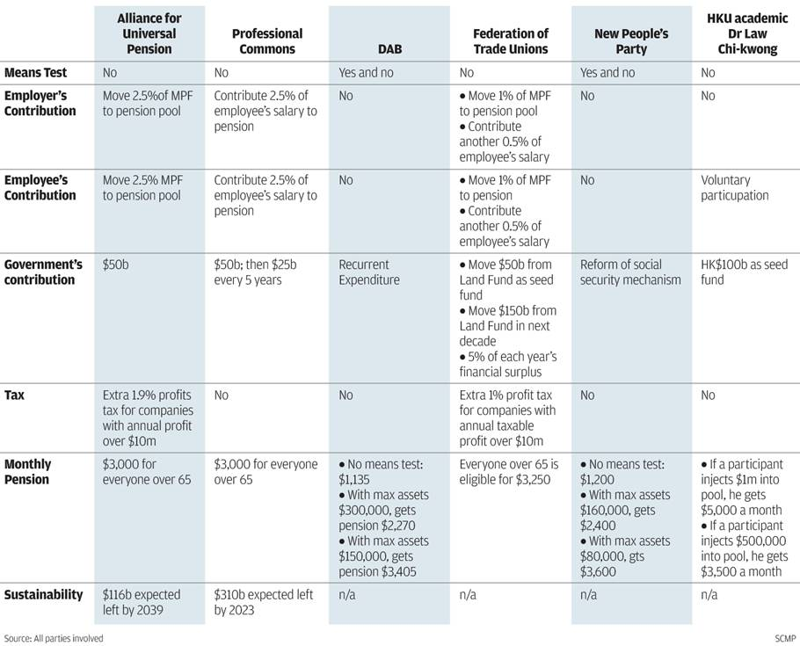
Current Issue: Proposals for pension plan in HK
Source: SCMP 20 August 2014
Notes:
Source: SCMP 20 August 2014 http://www.scmp.com/news/hong-kong/article/1578006/advocates-universal-pension-offer-choice-plans
The Commission on Poverty is currently conducting a public consultation on retirement protection, which has generated much discussion about how to improve Hong Kong's retirement protection. Regardless
of how the retirement protection framework develops in future, the MPF System will continue to play a vital role in helping members of the working population accumulate savings for retirement.

Slide 76
Current Issue: MPF fees & performance
Comparison of fees across different pensions systems
Notes:
Source: PWC – 2017_ recommendations for MPF

Slide 77
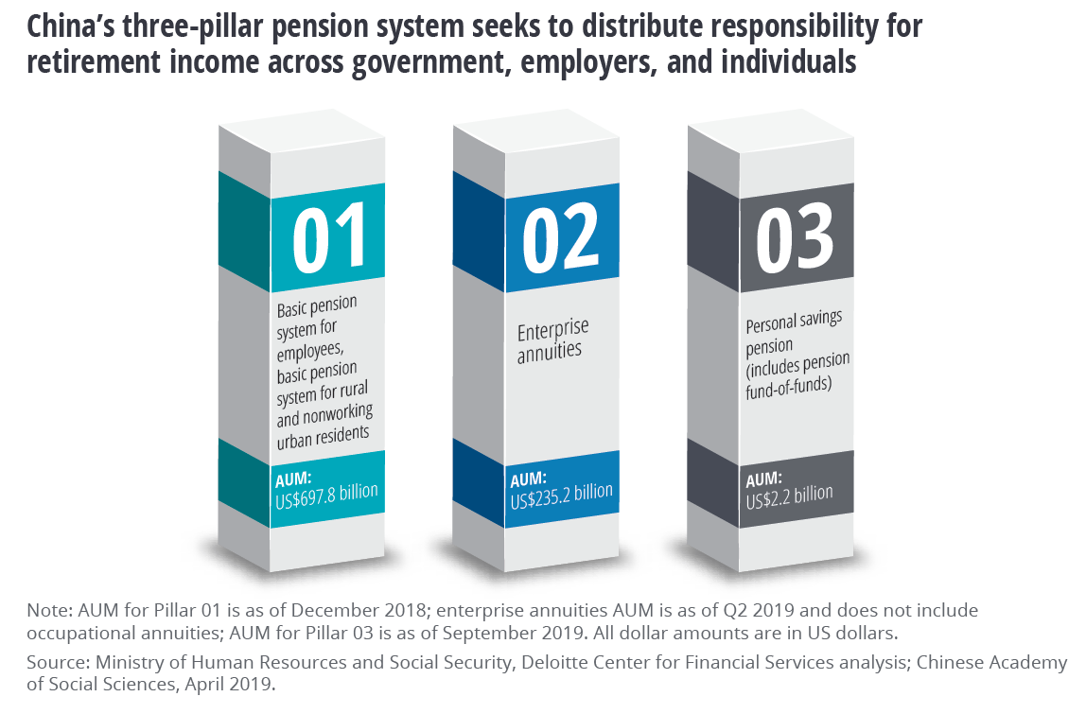
China’s Pension and Retirement System

Slide 78
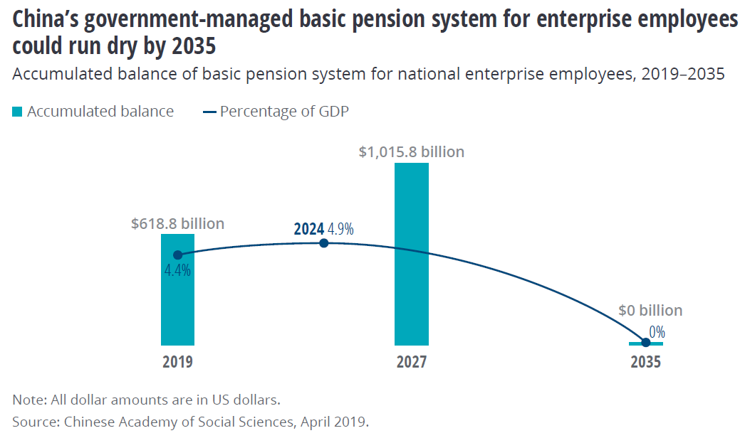
China’s Pension and Retirement System

Slide 79
Current issues: Retirement funds and pension funds in Asia: which country has the most advanced system? What is the situation in China? Implications? (Group 14)
Video Link
https://www.youtube.com/watch?v=eTzoLp5FIy0
Article
https://www.pensionfundsonline.co.uk/content/country-profiles/singapore

Slide 80
Current Issues for Pension Funds and Retirement Plans
Impact of crisis
Ageing of population presents critical issues for public pension funds – particularly Social Security plans
Longevity risk: Increase in life expectancy raises the question of retirement age
Changes in accounting for pensions driving a change in asset allocations
Rising trend of quest for yield driving increased participation of pension and retirement funds in alternative investments, raising issues of risk
“If I were a DB plan sponsor, I’d certainly be concerned about longevity risks. In the recent 20 years or so, we haven’t projected as rapid improvements (in lifespans) as what was actually happening. That is having huge repercussions on the actual cost of providing pensions.” Samuel Cox, Thomas P. Bowles Jr. chair of actuarial science at Georgia State University, Atlanta
Notes:
There are no known statistics showing the extent to which U.S. pension funds are underestimating the cost of providing pensions due to longevity risks. But according to analysis by Paternoster U.K. Ltd., London, U.K. defined benefit funds may come up short by £75 billion ($147 billion) to £175 billion because longevity risks have not been fully factored into the total pension liability, which stands about £1 trillion nationwide.

Slide 81
Total US Retirement Assets and Unfunded Defined Benefit Plan Liabilities Trillions of $, year-end
Source: Investment Company Factbook 2019

Slide 82
Size of Retirement Savings Gap $ trillions, 2015
Source: WEF, 2019 report

Slide 83
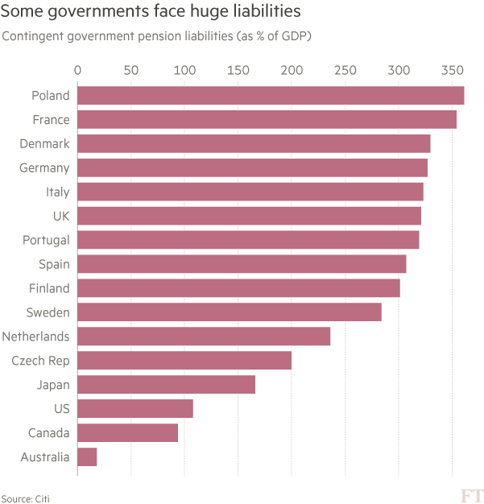
Government pension liabilities
Source: FT 24 August 2016
Notes:
Source: FT 23 Aug 2016 “Pensions: low yields, high stress” https://www.ft.com/content/8a54a0c6-648b-11e6-a08a-c7ac04ef00aa?ftcamp=crm/email//nbe/Analysis/product

Slide 84
Summary
Key issues affecting the pension and retirement industry

Slide 85
Course Map
Overview
Financial Institutions
Sell Side
Buy Side
Insurance Companies
Pension Funds and Retirement Schemes
Mutual Funds and Fund Management
Commercial Banking
Traditional Institutional Investors
Investment Banking
Spring 10

Slide 86
Mutual Funds & Collective Investment Schemes
Overview
Market
Pros & Cons of Collective Investment Schemes
Mutual Funds
Growth of mutual funds
Mutual funds structure & organization
Types of funds
Fee structure
Regulation
Mutual funds and asset management in HK and Asia

Slide 87
Worldwide Regulated Open-End Fund Assets - Trillions of U.S. dollars, 2010-2019 – by assets
Source: IC Fact Book 2020
Notes:
Source: IC Fact Book 2020 https://ici.org/pdf/2020_factbook.pdf

Slide 88
Total Net Assets of Worldwide Regulated Open-End Funds – by region Trillions of U.S. dollars, 2010-2019
Source: IC Fact Book 2020
Notes:
Source: IC Fact Book 2020 https://www.ici.org/pdf/2020_factbook.pdf

Slide 89
Percentage of Worldwide Regulated Open-End Fund Assets – YE 2019
Source: IC Fact Book 20189
Notes:
Source: IC Fact Book 2020 https://www.ici.org/pdf/2020_factbook.pdf
Source: ICI What Are Regulated Funds?
ICI, following standards set by the International Investment Funds Association (IIFA), defines regulated funds as collective investment pools that are substantively regulated, open-end investment funds.*
Open-end funds generally are defined as those that issue new fund shares (or units) or redeem existing shares (or units) on demand. Such funds are typically regulated with respect to disclosure, the form of organization (for example, as either corporations or trusts), custody of fund assets, minimum capital, valuation of fund assets, and restrictions on fund investments, such as limits on leverage, types of eligible investments, and diversification of portfolio investments.
In the United States, regulated funds include mutual funds and exchange-traded funds (ETFs).†
In Europe, regulated funds include Undertakings for Collective Investment in Transferable Securities (UCITS)—ETFs, money market funds, and other categories of similarly regulated funds—and alternative investment funds, commonly known as AIFs.
In many countries, regulated funds also may include institutional funds (funds that are restricted to being sold to a limited number of non-retail investors), funds that offer guarantees or protection of principal (those that offer a formal, legally binding guarantee of income or capital), and open-end real estate funds (funds that invest directly in real estate to a substantive degree).

Slide 90
Investment Company Industry Employment Estimated number of employees of fund sponsors and their service providers, thousands, selected years
Source: IC Fact Book 2018
Notes:
Source: IC Fact Book 2018 https://www.ici.org/pdf/2018_factbook.pdf

Slide 91
Investment Company Industry Employment by Job Function (US) % of employees of fund sponsors and their service providers, March 2017
Source: IC Fact Book 2018
Notes:
Source: IC Fact Book 2018 https://www.ici.org/pdf/2018_factbook.pdf

Slide 92
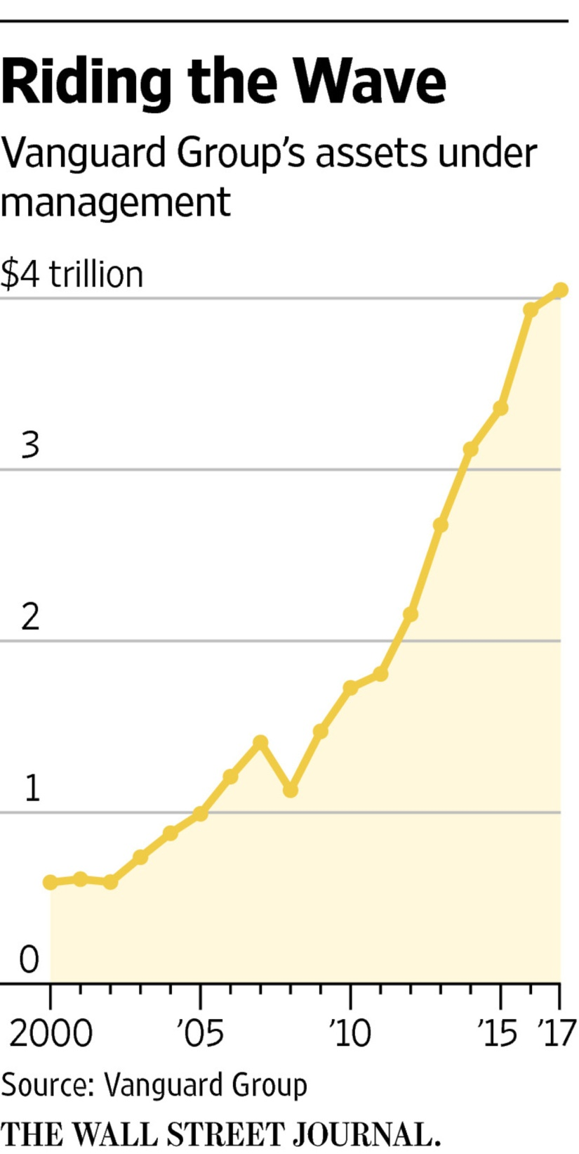
Vanguard’s AuM
Vanguard, which started the first index mutual fund for individual investors 40 years ago, is No. 2 in the asset-management world behind New York-based BlackRock Inc., another money-management giant benefiting from shifting investor tastes.
BlackRock topped $5 trillion in assets late last year for the first time. It has a larger international business than Vanguard.
Source: WSJ 10 Feb 17 “Vanguard Reaches $4Trillion for First Time”
Notes:
Source: WSJ 10 Feb 17 “Vanguard Reaches $4Trillion for the First Time” https://www.wsj.com/articles/vanguardreaches-4-trillion-for-first-time-1486745349

Slide 93
Five principal benefits of collective investment
Liquidity intermediation: investors can quickly convert investments into cash while still allowing the fund to invest for the long term.
Denomination intermediation: investors can participate in equity and debt offerings that, individually, require more capital than they possess.
Diversification: investors immediately realize the benefits of diversification even for small investments.
Cost advantages: the mutual fund can negotiate lower transaction fees than would be available to the individual investor.
Managerial expertise: many investors prefer to rely on professional money managers to select their investments.
Source: Mishkin/Eakins

Slide 94
Disadvantages of Collective Investments
Costs Despite Negative Returns: Fees and expenses are due regardless of how the fund performs.
Lack of Control: Investors typically cannot ascertain the exact make-up of a fund's portfolio at any given time, nor can they directly influence which securities the fund manager buys and sells or the timing of those trades.
Price Uncertainty: Unlike common stocks, the price at which you purchase or redeem shares in a mutual fund will typically depend on the fund's NAV, which the fund might not calculate until many hours after you've placed your order. In general, mutual funds must calculate their NAV at least once every business day, typically after the major U.S. exchanges close.
Source: SEC
Notes:
Costs Despite Negative Returns - Investors must pay sales charges, annual fees, and other expenses (which we'll discuss below) regardless of how the fund performs. And, depending on the timing of their investment, investors may also have to pay taxes on any capital gains distribution they receive - even if the fund went on to perform poorly after they bought shares.
Lack of Control - Investors typically cannot ascertain the exact make-up of a fund's portfolio at any given time, nor can they directly influence which securities the fund manager buys and sells or the timing of those trades.
Price Uncertainty - With an individual stock, you can obtain real-time (or close to real-time) pricing information with relative ease by checking financial websites or by calling your broker. You can also monitor how a stock's price changes from hour to hour - or even second to second. By contrast, with a mutual fund, the price at which you purchase or redeem shares will typically depend on the fund's NAV, which the fund might not calculate until many hours after you've placed your order. In general, mutual funds must calculate their NAV at least once every business day, typically after the major U.S. exchanges close.

Slide 95
Investment Companies Channel Investment to securities markets % of total market securities held by investment companies, year-end 2015–2018
Source: Investment Company Factbook 2019

Slide 96
Summary
Pros and cons of collective investment

Slide 97
Test Your Understanding
Investors in mutual funds benefit most from denomination intermediation when they seek to invest in
Small Stocks
Bonds
One of the disadvantages of investing through mutual funds is
No control over investments
Costs irrespective of performance
Dependence on other investors behavior
All of the above
None of the aboe

Slide 98
Distinguishing Features of Mutual Funds
Investors purchase mutual fund shares from the fund itself (or through a broker for the fund) instead of from other investors on a secondary market, such as the New York Stock Exchange or Nasdaq Stock Market
The price = the fund's per share net asset value (NAV) plus any shareholder fees that the fund imposes at the time of purchase (such as sales loads)
Mutual fund shares are "redeemable," meaning investors can sell their shares back to the fund (or to a broker acting for the fund)
Mutual funds generally create and sell new shares to accommodate new investors. In other words, they sell their shares on a continuous basis, although some funds stop selling when, for example, they become too large
The investment portfolios of mutual funds typically are managed by separate entities known as "investment advisers" that are registered with the SEC
Source: SEC

Slide 99
Mutual Fund Structure
Closed-End Fund: a fixed number of nonredeemable shares are sold through an initial offering and are then traded in the OTC market. Price for the shares is determined by supply and demand forces.
Open-End Fund: investors may buy or redeem shares at any point, where the price is determined by the net asset value of the fund.
Source: Mishkin/Eakins

Slide 100
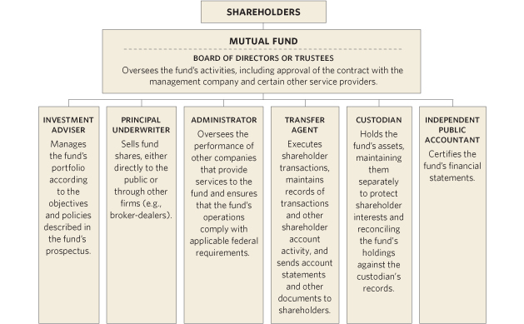
The Organizational Structure of a Mutual Fund
Source: ICI
Notes:
Source: http://www.icifactbook.org/fb_appa.html#organization
The shareholders, or owners, of the mutual fund are the investors.
The board of directors oversees the fund’s activities, hires the investment advisor, an underwriter, etc., to manage the day to day operations of the fund.
In theory, the board can fire the fund manager and hire anyone they choose.
For instance, the board for the Fidelity Magellan Fund can fire Fidelity. Of course, if the board hires a non-Fidelity management team, the fund will probably lose its name, and its reputation along with it
The Organization of a Mutual Fund
Individuals and institutions invest in a mutual fund by purchasing shares issued by the fund. It is through these sales of shares that a mutual fund raises the cash used to invest in its portfolio of stocks, bonds, and other investments. Each investor owns a pro rata share of the fund’s investments and shares in the returns from the fund’s portfolio while benefiting from professional investment management, diversification, and liquidity. Mutual funds may offer other benefits and services, such as asset allocation programs or check-writing privileges on money market fund accounts.
A mutual fund is organized under state law either as a corporation or a business trust (sometimes called a “statutory trust”). Mutual funds have officers and directors or trustees. In this way, mutual funds are like any other type of operating company, such as Exxon or Google. Unlike other companies, however, a mutual fund is typically externally managed; it is not an operating company and it has no employees in the traditional sense. Instead, a fund relies upon third parties or service providers that are either affiliated organizations or independent contractors to invest fund assets and carry out other business activities. The diagram below shows the primary types of service providers usually relied upon by a fund.
Although it typically has no employees, a fund is required by law to have its own written compliance program, overseen by an individual designated as a chief compliance officer. This compliance program establishes detailed procedures and internal controls designed to ensure compliance with all relevant laws and regulations.
How a Fund Is Created
Setting up a mutual fund is a complicated process performed by the fund’s sponsor, typically the fund’s investment adviser, administrator, or principal underwriter (also known as its distributor).
The fund sponsor has a variety of responsibilities. For example, it must assemble the group of third parties needed to launch the fund, including the persons or entities charged with managing and operating the fund. The sponsor provides officers and affiliated directors to oversee the fund, and recruits unaffiliated persons to serve as independent directors.
Some of the major steps in the process of starting a mutual fund include organizing the fund under state law as either a business trust or corporation, registering the fund with the SEC as an investment company pursuant to the Investment Company Act of 1940, and registering the fund shares for sale to the public pursuant to the Securities Act of 1933. Unless otherwise exempt from doing so, the fund must also make filings and pay fees to each state (except Florida) in which the fund’s shares will be offered to the public. The Investment Company Act also requires that each new fund have at least $100,000 of seed capital before distributing its shares to the public; this capital is usually contributed by the adviser or other sponsor in the form of an initial investment.

Slide 101
Unit Trusts vs. Mutual Funds
 | Unit Trusts | Mutual Funds
Form of establishment | Trust | Limited liability company
Beneficiary | Unit holder | Shareholder
Governing law | Trust law | Company law
Legal document in which the rules are laid down | Trust deed | Company’s articles/bye laws & custodian agreements
Who protects investor interests | Trustee | Custodian (but according to the custodian agreement and articles/bye laws)
Who owns or holds the fund assets | Trustee holds the assets for the benefit of the investors | The mutual fund company owns the assets and investors are shareholders of the company
Who is liable | Trustee | The company has limited liability; directors can be liable
Source: http://www.hkifa.org.hk/eng/download/about_publications/E_FundInv.pdf
Notes:
The key difference between unit trusts and mutual funds lie in the legal structure. Both are the same from an investment perspective, and in HK both are SFC regulated.

Slide 102
Types of Mutual Funds
Mutual Funds
Short Term
Taxable MMMF
Tax-Exempt MMMF
Medium/Long Term
Bond Funds
Equity Funds
Index Funds
Hybrid Funds
Specialised funds
Notes:
Short Term
Money market funds
Medium & Long Term
Stock (Equity) funds
Bond funds
Warrants & derivatives funds
Hybrid funds (Asset Allocation Funds)

Slide 103
In the US, Equity Mutual Funds Held More Than Half of Mutual Fund and ETFs Total Net Assets Percentage of total net assets, year-end 2019
Source: Investment Company Factbook 2020
Notes:
Source: IC Fact Book 2020 https://www.ici.org/pdf/2020_factbook.pdf

Slide 104
Money Market Mutual Funds
Money market funds are a type of mutual fund registered under the Investment Company Act of 1940 and regulated under rule 2a-7 of the Act.
Money market funds pay dividends that reflect prevailing short-term interest rates, are redeemable on demand, and, unlike other investment companies, seek to maintain a stable NAV, typically $1.00. This combination of principal stability, liquidity and payment of short-term yields has made money market funds popular cash management vehicles for both retail and institutional investors.
There are many kinds of money market funds, including ones that invest primarily in government securities, tax-exempt municipal securities, or corporate debt securities.
Money market funds that primarily invest in corporate debt securities are referred to as prime funds.
Source: ICI
Notes:
Source: http://www.ici.org/faqs/faqs_money_funds
Money market funds have relatively low risks, compared to other mutual funds (and most other investments). By law, they can invest in only certain high-quality, short-term investments issued by the U.S. government, U.S. corporations, and state and local governments. Money market funds try to keep their net asset value (NAV) — which represents the value of one share in a fund — at a stable $1.00 per share. But the NAV may fall below $1.00 if the fund's investments perform poorly. Investor losses have been rare, but they are possible.
Money market funds pay dividends that generally reflect short-term interest rates, and historically the returns for money market funds have been lower than for either bond or stock funds. That's why "inflation risk" — the risk that inflation will outpace and erode investment returns over time — can be a potential concern for investors in money market funds.

Slide 105
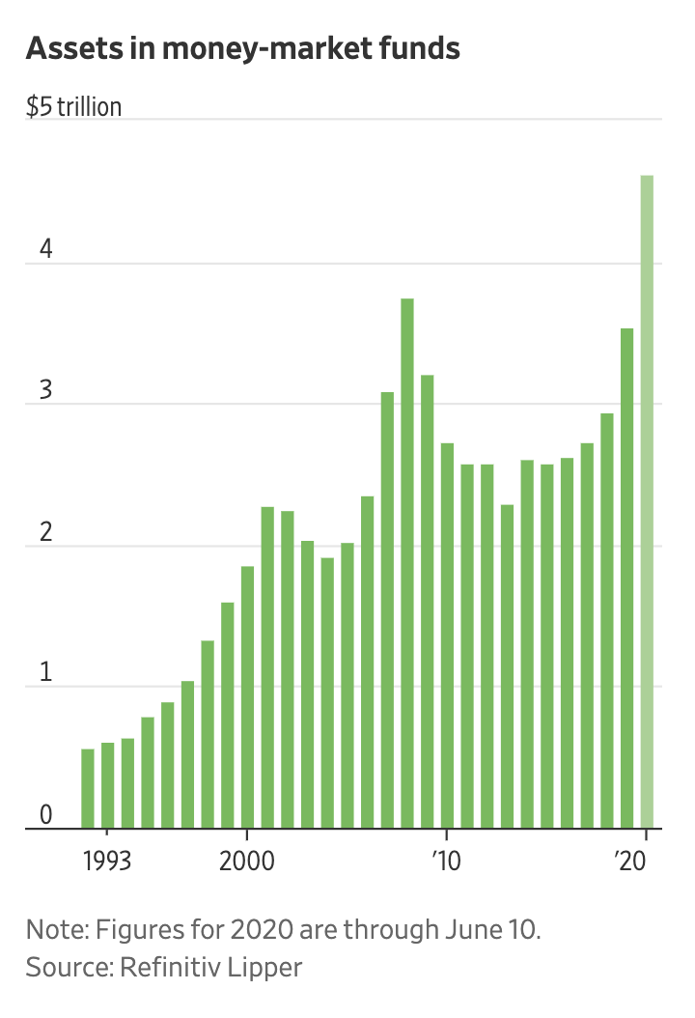
Assets in MMF
Assets in MM funds recently swelled to about $4.6 trillion, the highest level on record, according to data from Refinitiv Lipper going back to 1992.
Assets in money-market funds have grown by about $1 trillion this year, pushing assets in these funds above the prior high of roughly $3.8 trillion reached during the last financial crisis.
Notes:
Source: Aug 20 https://ritholtz.com/wp-content/uploads/2020/06/cashpile.png and WSJ https://www.wsj.com/articles/investors-are-sitting-on-the-biggest-pile-of-cash-ever-11592299801
Like many other investors, Mr. Cunnison has been struggling to reconcile the divergences between the deteriorating economy and the improving stock market.
“It does justify some higher level of caution and resilience in portfolios than you otherwise would have,” Mr. Cunnison said. “We’re still comfortable with a slightly higher level of cash.”
Jeremy Grantham of GMO LLC, who earned acclaim with his calls ahead of Wall Street busts in 2000 and 2008, wrote in a quarterly letter that stock-market valuations are among the highest they have been historically, while the U.S. economy is about as abysmal as it has been.
“Everyone can see and feel that this is different and can sense the bizarre nature of the market response: we are in the top 10% of historical price earnings ratio for the S&P on prior earnings and simultaneously are in the worst 10% of economic situations,” Mr. Grantham wrote in his letter to investors.

Slide 106
MMF vs. MMDA
A money market fund is a type of mutual fund. It is not guaranteed or FDIC insured. When you buy shares in a money market fund, you should receive a prospectus.
A money market deposit account is a bank deposit. It is guaranteed and FDIC insured. When you deposit money in a money market deposit account, you should receive a Truth in Savings form.
Notes:
Are “enhanced cash management” products the same as money market funds?
Source: http://www.ici.org/faqs/faqs_money_funds
No. An enhanced cash fund generally refers to a fund that is typically not registered with the SEC and that seeks yields slightly higher than those of money market funds by investing in a wider array of securities that tend to have longer maturities and lower credit quality. In seeking those yields, however, enhanced cash funds are not subject to and therefore need not abide by the SEC rule restrictions imposed on money market funds governing the credit quality, liquidity, diversification, and maturity of investments. Enhanced cash funds target a $1.00 NAV, but have much greater potential exposure to fluctuations in their portfolio valuations. Enhanced cash funds are privately offered to institutions, wealthy clients, and certain types of trusts. They may also be referred to as "money market plus funds," "money market-like funds," "enhanced yield funds," or "3(c)(7) funds" (after the legal exception from regulation under the Investment Company Act of 1940, upon which they rely).

Slide 107
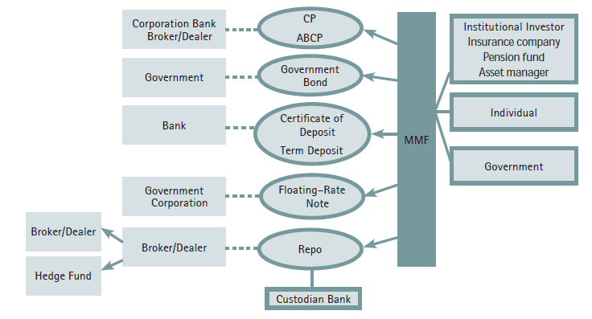
The Basic Functioning of a MMF in the United States
Source: IIF report on Shadow Banking
Notes:
Source: IIF report on Shadow Banking http://www.iif.com/regulatory/

Slide 108
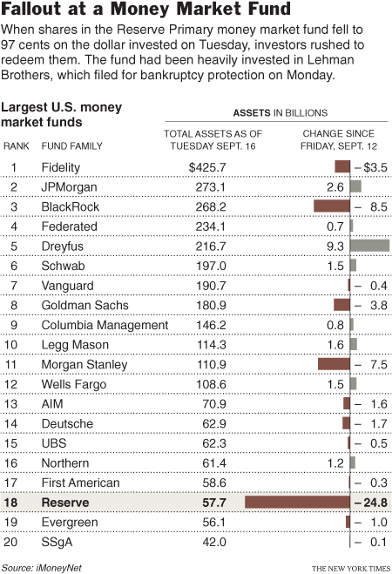
Breaking the buck – what is safe?
“It used to be O.K. to have money in a CD, but now you have to worry, ‘Is my bank going to go under?’ ” he added. “You used to be able to buy a guaranteed annuity from an insurance company, but now you have to worry, ‘Is my insurance company going to go under?’ Or, you can have auction-rate preferred securities, but now there is no market.”
Source: New York Times 17 September 2008: “Money Market Funds Enter a World of Risk “
Notes:
Source: http://www.nytimes.com/2008/09/18/business/yourmoney/18money.html?_r=1&em&oref=slogin
Money Market Funds Enter a World of Risk
Source: http://www.ici.org/faqs/faqs_money_funds
What does it mean when I hear that a money market fund “broke the dollar” (or “broke the buck”)?
If an adverse event—such as the downgrade or default of a portfolio security or a sudden sharp increase in short-term interest rates—pushes the market value of a fund's portfolio below $0.9950 per share and the fund's board decides to discontinue the use of the amortized cost method of valuation, the fund is said to "break the dollar," or "break the buck." When a fund breaks the dollar, shares are redeemed and investors are repaid at the fund's NAV, calculated on the day investors place their redemption order.
This has happened twice since the inception of money market funds. In 1994, a small institutional money fund broke the dollar; investors ultimately received 96 percent of their principal. On September 16, 2008, a money market fund announced that its NAV that day was 97 cents, due to a sharp write-down in some securities the fund held. That fund would later be liquidated. In September 2009, the SEC and the fund’s independent trustees estimated that investors would recover approximately 99 percent of their principal, or 99 cents per share.
What happens to investors when a money market fund closes and liquidates?
If a fund has broken the dollar, or is at imminent risk of breaking the dollar, it may close to new investors, suspend redemptions, and distribute its assets to investors, in accordance with a plan of liquidation. A fund might do this to provide equitable treatment to all investors in the face of significant redemption pressure that might lead to a forced sale of the fund’s assets.

Slide 109
MMF Regulations - 2010
Money market funds are strictly regulated by the SEC, both as mutual funds generally and pursuant to Rule 2a-7 under the Investment Company Act of 1940.
Rule 2a-7 includes several conditions that limit risk in a money market fund’s portfolio by governing the credit quality, liquidity, diversification, and maturity of money market fund investments.
The Securities and Exchange Commission (SEC) in January 2010 approved amendments to Rule 2a-7 under the Investment Company Act of 1940. The amendments tighten fund liquidity requirements, impose stricter quality requirements, address reliance on rating agencies, impose stricter maturity limits, require enhanced disclosure of portfolio holdings and address issues that arise when a money market fund experiences market challenges.
Funds that meet Rule 2a-7's risk-limiting provisions are allowed to value their securities at amortized cost, rather than at market value. This allows the fund to value its shares at a fixed price (usually $1.00) under a wide range of market conditions.
Source: ICI
Notes:
Source: https://www.ici.org/mmfs/current/16_mmf_reg_summ
Money market funds are strictly regulated by the SEC, both as mutual funds generally and pursuant to Rule 2a-7 under the Investment Company Act of 1940. Rule 2a-7 includes several conditions intended to help a fund stabilize its share price at $1.00. These conditions limit risk in a money market fund’s portfolio by governing the credit quality, liquidity, diversification, and maturity of money market fund investments.
Money market funds are required to regularly calculate their portfolios’ per-share value at market prices, also known as their “shadow price.” While money market funds have routinely calculated shadow prices for decades, and disclosed them semi-annually, the SEC’s 2010 amendments to Rule 2a-7 now require funds to disclose these shadow prices on a monthly basis (with a 60-day lag) to four decimal places (e.g., $1.0005 or $0.9995). For more information, please see ICI's Frequently Asked Questions About Pricing of U.S. Money Market Funds.
The Securities and Exchange Commission (SEC) in January 2010 approved amendments to Rule 2a-7 under the Investment Company Act of 1940, the rule that governs the operations of money market funds. 1 The amendments tighten fund liquidity requirements, impose stricter quality requirements, address reliance on rating agencies, impose stricter maturity limits, require enhanced disclosure of portfolio holdings and address issues that arise when a money market fund experiences market challenges. The amendments are designed to make money market funds more resilient to certain short-term market risks, and to provide greater protections for investors in a money market fund that is unable to maintain a stable net asset value (NAV) per share.
In January 2010, the SEC approved amendments to Rule 2a-7 that would strengthen money market funds by:
tightening standards for credit quality of fund assets;
shortening portfolio maturities;
enhancing disclosure;
requiring funds to meet explicit standards for holding liquid assets; and
requiring stress testing and “know your customer” procedures to help funds to be prepared for redemption pressure in a market crisis.
The new rules also permit a money market fund that has broken the dollar, or that is at imminent risk of breaking the dollar, to suspend redemptions and liquidate to ensure that all investors—regardless of who is first through the door—are treated fairly.

Slide 110
Regulation of MMMF
Credit Quality: At least 97 % of a money market fund’s assets must be invested in securities that receive the highest short-term rating or securities of comparable quality (known as “First Tier Securities”).
Liquidity: all taxable funds must maintain 10 % of assets in “daily liquid assets,” which means cash, U.S. Treasuries, or securities that mature or are subject to a demand feature within one business day. All funds also must have 30 % of assets in “weekly liquid assets,” which means cash, U.S. Treasuries, other government securities with remaining maturities of 60 days or less, or securities that mature or are subject to a demand feature within five business days.
Diversification: money market funds may not invest more than 5 % of assets in the securities of any single issuer. The limit is set at 0.5 % if the issuer has received ratings in the second highest short-term rating category .
Maturity: Money market funds cannot acquire a portfolio security with a remaining maturity of greater than 397 days . Money market funds are required to maintain a dollar-weighted average maturity of 60 days or less and a weighted average life maturity of 120 days or less without consideration of interest rate reset dates on variable-or floating-rate securities.
Source: ICI
Notes:
Credit Quality: Money market funds are required to hold high-quality securities that pose minimal credit risks and have received ratings in the top two categories from two nationally-recognized statistical rating organizations (NRSROs) (unless only one NRSRO rates the security or issuer of debt), or are securities of comparable quality. At least 97 percent of a money market fund’s assets must be invested in securities that receive the highest short-term rating or securities of comparable quality (known as “First Tier Securities”).
Liquidity: Money market funds must maintain sufficient portfolio liquidity to meet reasonably foreseeable redemption requests. The rule also includes a requirement that all taxable funds maintain 10 percent of assets in “daily liquid assets,” which means cash, U.S. Treasuries, or securities that mature or are subject to a demand feature within one business day. All funds also must have 30 percent of assets in “weekly liquid assets,” which means cash, U.S. Treasuries, other government securities with remaining maturities of 60 days or less, or securities that mature or are subject to a demand feature within five business days.
Diversification: Money market funds must maintain a diversified portfolio. This requirement limits a fund’s economic exposure to any single issuer. In general, money market funds may not invest more than 5 percent of assets in the securities of any single issuer. Rule 2a-7 makes exceptions to the 5 percent limit for certain securities, including those issued by the federal government or its agencies. The limit is set at 0.5 percent if the issuer has received ratings in the second highest short-term rating category (known as “Second Tier Securities”).
Maturity: Money market funds must invest in securities that are considered “short-term.” Money market funds cannot acquire a portfolio security with a remaining maturity of greater than 397 days (though exceptions are made for certain types of securities—including variable and floating rate securities—that have an interest rate reset of no more than 397 days or a demand feature). In addition, a money market fund’s weighted average maturity (WAM)—an average of the maturities of all securities held in the portfolio, weighted by each security’s percentage of net assets—must not exceed 60 days and 120 days, determined without reference to exceptions for interest rate readjustments.
Funds that meet Rule 2a-7's risk-limiting provisions are allowed to value their securities at amortized cost, rather than at market value. This allows the fund to value its shares at a fixed price (usually $1.00) under a wide range of market conditions.

Slide 111
2014 amendments (effective 2016)
The new rules :
require a floating net asset value (NAV) for institutional prime money market funds, which allows the daily share prices of these funds to fluctuate along with changes in the market-based value of fund assets These funds no longer will be allowed to use the special pricing and valuation conventions that used to permit them to maintain a constant share price of $1.00.
provide non-government money market fund boards new tools – liquidity fees and redemption gates – to address runs.
Notes:
Source: SEC http://www.sec.gov/News/PressRelease/Detail/PressRelease/1370542347679

Slide 112
Current issues about money market funds
Regulators worry about the impact of MMF in the financial system particularly whether the funds present systemic risk
The European crisis has caused many funds to pull out of the European market, severely impacting Eurozone banks funding capacity
Funds have suffered from low interest rate environment with investors pulling money out of the funds;
NIRP is affecting the business model

Slide 113
Summary
Mutual Funds
Features
Structure
Organisation
Money Market Funds
Definitions
Regulations
Understanding the Reserve Fund crisis and consequences

Slide 114
Index Funds and the shift to passive investing
Index Funds
Seek to replicate the performance of a given benchmark (index). For example, an S&P 500 index fund would hold the equities comprising the S&P 500.
Offers benefits of traditional mutual funds without the fees of the professional money manager.

Slide 115
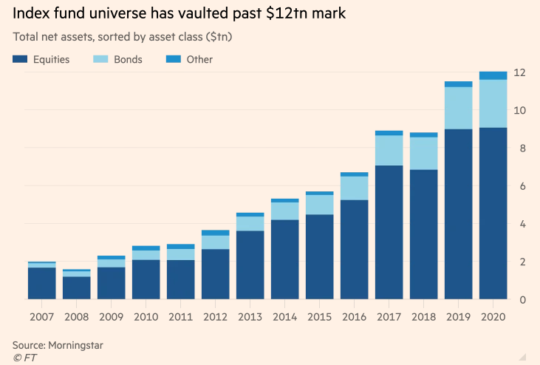
Index Funds
Source: FT 28 Dec 2020
Notes:
Source: FT 28 Dec 2020 https://www.ft.com/content/bd8ce72b-6104-4d1c-a4a9-78cd815c68b1?segmentId=114a04fe-353d-37db-f705-204c9a0a157b

Slide 116
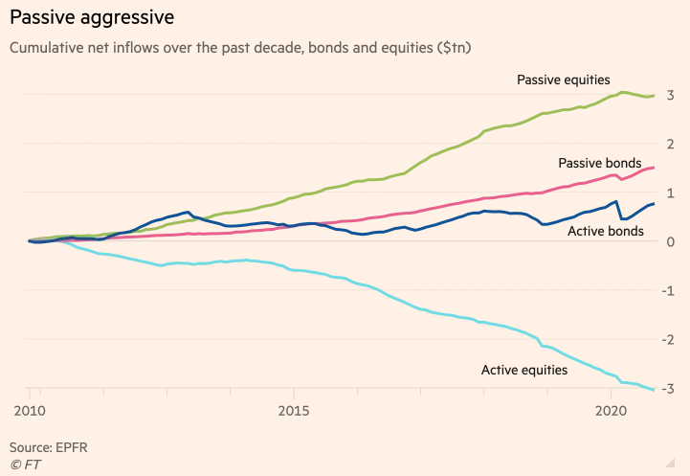
Passive v. Active
Source: FT 28 Dec 2020
Notes:
Source: FT 28 Dec 2020 https://www.ft.com/content/bd8ce72b-6104-4d1c-a4a9-78cd815c68b1?segmentId=114a04fe-353d-37db-f705-204c9a0a157b
Source: FT 28 Dec 2020 https://www.ft.com/content/bd8ce72b-6104-4d1c-a4a9-78cd815c68b1?segmentId=114a04fe-353d-37db-f705-204c9a0a157b

Slide 117
Index Funds Have Grown as a Share of the Fund Market Percent, year-end 2009 and 2019
Source: Investment Company Factbook 2020
Notes:
Source: IC Fact Book 2020 https://www.ici.org/pdf/2020_factbook.pdf

Slide 118
Total Net Assets and Number of Index Mutual Funds Have Increased in Recent Years Billions of dollars; year-end, 2009–2019
Source: Investment Company Factbook 2020

Slide 119
Exchange Traded Funds (ETFs)
ETFs are investment funds generally designed to track a particular index (generally stock index e.g. Footsie)
Investors buy shares in the ETF
Open-ended → fund grows and shrinks with purchase/sale
ETF shares are traded on the stock exchange
shares bought/sold through brokers – investors pay commissions on the trades
No premium/discount
shares reflect the value of the investment in the fund
there is a small spread (bid/offer prices)
an annual management charge is deducted from the fund
No stamp duty on purchases (unlike other shares)
ETFs in the US: "Exchange-traded funds" (ETFs) are a type of investment company that aims to achieve the same return as a particular market index. They can be either open-end companies or UITs. But ETFs are not considered to be, and are not permitted to call themselves, mutual funds.
Source: SIIUK
Notes:
Exchange-Traded Funds — a type of an investment company (either an open-end company or UIT) whose objective is to achieve the same return as a particular market index. ETFs differ from traditional open-end companies and UITs, because, pursuant to SEC exemptive orders, shares issued by ETFs trade on a secondary market and are only redeemable from the fund itself in very large blocks (blocks of 50,000 shares for example).
Tracking error is the difference between the ETF’s return and that of the index it’s supposed to duplicate. Funds that track the big indices rarely go far astray; the misfires happen when ETFs try to match more esoteric indices. Foreign ETFs in particular often veer off the track, because the fund can’t buy all the locally listed shares it needs. Sometimes regulatory barriers affect a fund’s performance: for example, securities regulations bar a fund from having more than ¼ of its assets in a single company’s stock, which is a problem when the index the fund tries to replicate has high concentration of one stock.
The job of an ETF manager is to manage vs. the index. The only source of errors should be fees.
What Is an ETF?
(Source: http://www.icifactbook.org/fb_ch3.html)
An ETF is an investment company, typically a mutual fund or unit investment trust, whose shares are traded intraday on stock exchanges at market-determined prices. Investors may buy or sell ETF shares through a broker just as they would the shares of any publicly traded company.
ETFs are a relatively recent innovation to the investment company concept. The first ETF—a broad-based domestic equity fund tracking the S&P 500 index—was introduced in 1993 after a fund sponsor received U.S. Securities and Exchange Commission (SEC) exemptive relief from various provisions of the Investment Company Act of 1940 that would not otherwise allow the ETF structure. Until 2008, SEC exemptive relief was granted only to ETFs that tracked designated indexes. These ETFs, commonly referred to as index-based ETFs, are designed to track the performance of their specified indexes or, in some cases, a multiple of or an inverse (or multiple inverse) of their indexes.
In early 2008, the SEC first granted exemptive relief to several fund sponsors to offer fully transparent actively managed ETFs that meet certain requirements. These actively managed ETFs must disclose each business day on their publicly available websites the identities and weightings of the component securities and other assets held by the ETF. Actively managed ETFs do not seek to track the return of a particular index. Instead, an actively managed ETF’s investment adviser, like that of an actively managed mutual fund, creates a unique mix of investments to meet a particular investment objective and policy.
By the end of 2009, the total number of index-based and actively managed ETFs had grown to 797, and total net assets were $777 billion. Of these, 22 were actively managed ETFs with about $1.0 billion in total net assets.
ETFs and Mutual Funds
A registered ETF is similar to a mutual fund in that it offers investors a proportionate share in a pool of stocks, bonds, and other assets. It is most commonly structured as an open-end investment company and is governed by the Investment Company Act of 1940 like other mutual funds. For example, like a mutual fund, an ETF is required to post the mark-to-market net asset value (NAV) of its portfolio at the end of each trading day. Despite these similarities, key features differentiate ETFs from mutual funds.
Key Differences
One major difference is that retail investors buy and sell ETF shares on a stock exchange through a broker-dealer, much like they would any other type of stock. In contrast, mutual fund shares are not listed on stock exchanges. Rather, retail investors buy and sell mutual fund shares through a variety of distribution channels, including through a financial adviser, broker-dealer, or directly from a fund company.
Pricing also differs between mutual funds and ETFs. Mutual funds are “forward priced,” which means that although investors can place orders to buy or sell shares throughout the day, all orders placed during the day will receive the same price—the NAV—the next time it is computed. Most mutual funds calculate their NAV as of 4:00 p.m. eastern time because that is the time U.S. stock exchanges typically close. In contrast, the price of an ETF share is continuously determined on a stock exchange. Consequently, the price at which investors buy and sell ETF shares may not necessarily equal the NAV of the portfolio of securities in the ETF. In addition, two investors selling the same ETF shares at different times on the same day may receive different prices for their shares, both of which may differ from the ETF’s NAV.
ETFS FAQS : https://www.ici.org/pubs/faqs/faqs_etfs
What is an ETF?
An exchange-traded fund (ETF) is a pooled investment vehicle with shares that trade intraday on stock exchanges at a market-determined price. Investors may buy or sell ETF shares through a broker or in a brokerage account, just as they would the shares of any publicly traded company.
Unlike traditional mutual fund shares, ETF shares are created by “authorized participants” or APs—typically, large financial institutions—providing a specified basket of securities, cash, or both—often called a “creation basket”—to the ETF. In return, the AP receives a fixed amount of ETF shares, called a “creation unit.” Some or all of these shares may then be sold on a stock exchange. An AP may redeem ETF shares in creation unit increments in exchange for a “redemption basket” of securities, cash, or both.
Retail investors can only buy and sell the ETF shares on an exchange, much as they can buy or sell any listed equity security. Unlike an AP, a retail investor cannot purchase or redeem shares directly from the ETF, as with a traditional mutual fund.
How are ETFs regulated?
The vast majority of exchange-traded funds are registered with the SEC and, like mutual funds, must comply with the applicable provisions of the Investment Company Act of 1940 and exemptive orders issued under that Act. Different regulations apply to commodity-based ETFs, which hold about 3 percent of ETF assets. Those commodity-based ETFs that invest in commodity futures are regulated by the Commodity Futures Trading Commission (CFTC), while those that invest solely in physical commodities are regulated by the SEC under the Securities Act of 1933.

Slide 120
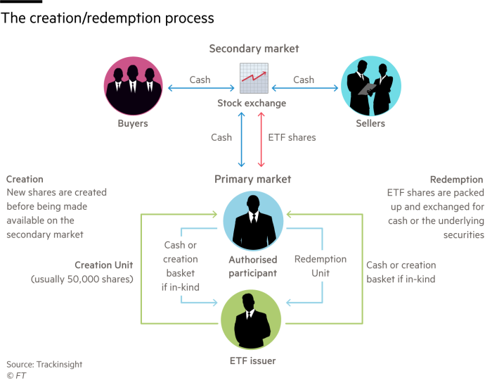
ETF
Notes:
Source: FT 8 October 2020 https://www.ft.com/content/f2685757-2639-424f-8f1e-0f4f981dadb9?segmentId=114a04fe-353d-37db-f705-204c9a0a157b

Slide 121
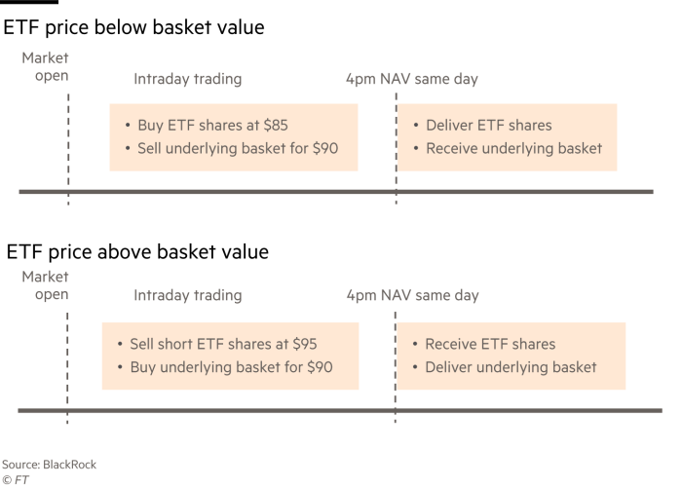
ETF – creation-redemption process
Notes:
Source: FT 8 October 2020 https://www.ft.com/content/f2685757-2639-424f-8f1e-0f4f981dadb9?segmentId=114a04fe-353d-37db-f705-204c9a0a157b

Slide 122
ETFs v. MFs 1996-2017
Source: SIFMA and ICI
Notes:
Source: SIFMA and ICI

Slide 123
The United States Has the Largest ETF Market Percentage of total net assets, year-end 2019
Source: Investment Company Factbook 2020
Notes:
Source: IC Fact Book 2020 https://www.ici.org/pdf/2020_factbook.pdf

Slide 124
Total Net Assets and Number of ETFs Billions of $, year end
Source: Investment Company Factbook 2020
Notes:
ICI Fact Book 2020

Slide 125
Top 10 ETF Managers

Slide 126
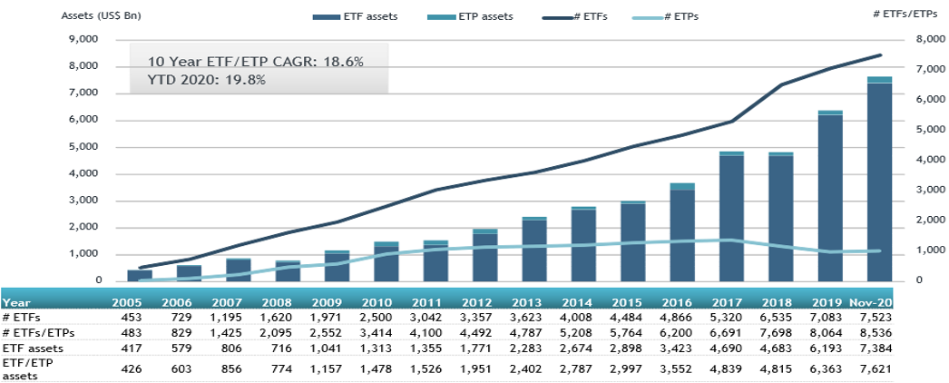
Growth of ETFs and ETPs
Source: ETFGI Dec 2020
Notes:
Source: ETFGI Dec 2020 https://etfgi.com/news/press-releases/2020/12/etfgi-reports-assets-invested-etfs-and-etps-listed-globally-reached-new
assets invested in ETFs and ETPs listed globally reached new records of US$7.62 trillion and net inflows reached a new record of US$670.57 billion at the end of November.
The Global ETF/ETP industry had 8,536 ETFs/ETPs, with 16,983 listings, assets of $7.62 Tn, from 501 providers listed on 74 exchanges in 60 countries at the end of November.

Slide 127
Key Issues with ETFs
Because shares in ETFs are traded like stocks, the prices reflect supply/demand not just the underlying value of the funds assets
Just like stocks, it is possible to buy options on ETFs or go short ETFs
As a result, in days of volatile trading, the share price of an ETF can diverge from the price of the assets it is tracking
ETF investors who sell in volatile markets may get significantly less than the assets are worth
Problems with synthetic ETFs where investors take risk on the ETF provider
Source: AWSJ, 19 March 2007 “Fast money folks embrace ETFs adding risk for smaller investors”

Slide 128
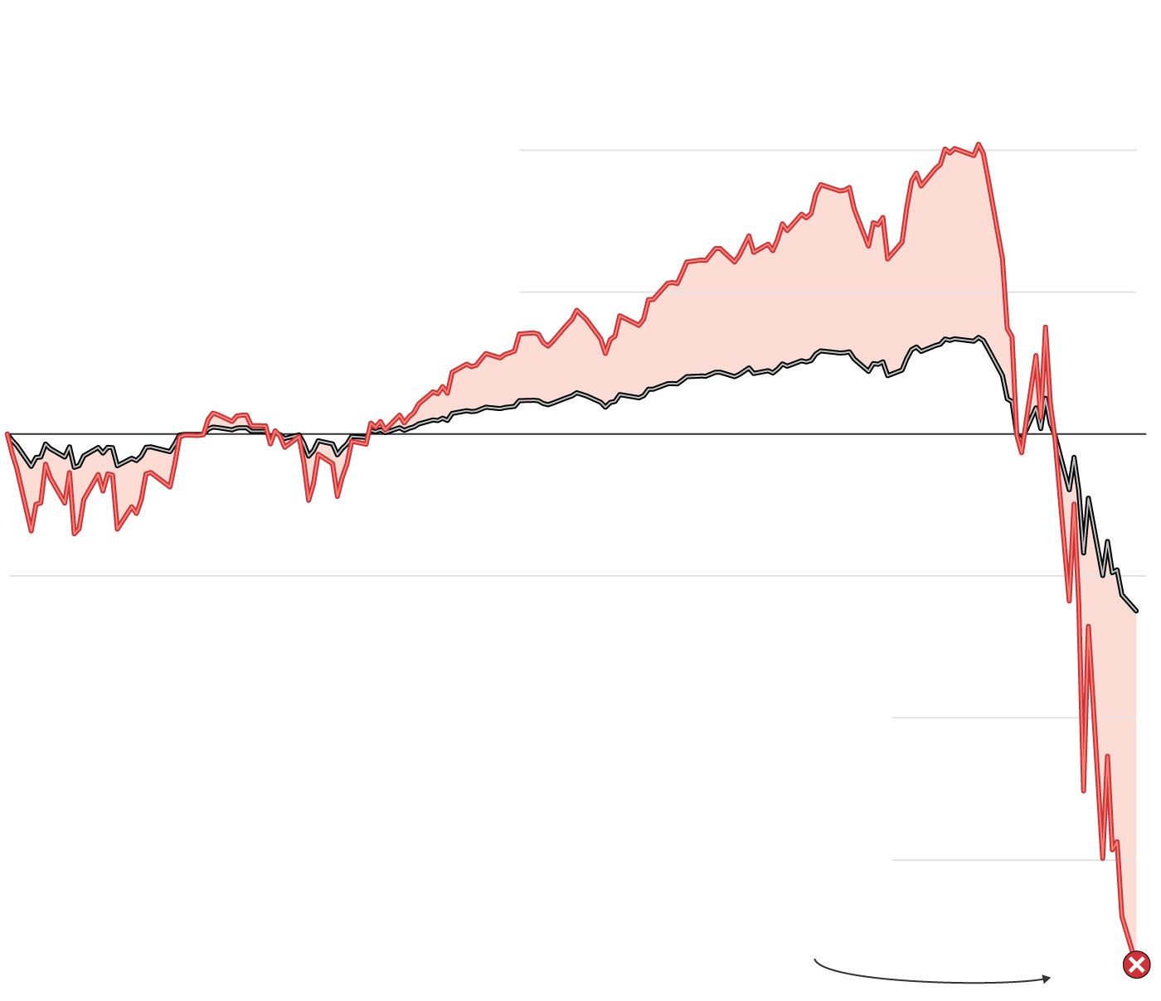
Leveraged ETNs
Investing on Steroids
Leveraged exchange-traded notes are complex financial instruments that use debt to amplify returns, which also increases risk.
When a bank issues a typical ETN, the security tracks the value of an underlying asset, such as crude oil or the S&P 500. As markets move, the value of the ETN changes in tandem.
3x leveraged ETN
Underlying asset
With a leveraged ETN,
the bank purchases
derivatives, often options,
with borrowed money to
increase the ETN’s
returns. An ETN with
three-times leverage
would triple any gains—
but also triple losses.
ETN holders can collect dividend payments if
the underlying assets increase in value, and they can buy or sell the notes on an exchange
If an ETN falls below a certain price, the bank has the option to redeem the note, often paying investors just a fraction of what they originally paid
Source: WSJ June 2020
Notes:
Source: WSJ https://www.wsj.com/articles/bankrupt-in-just-two-weeksindividual-investors-get-burned-by-collapse-of-complex-securities-11591020059?mod=trending_now_1

Slide 129
Summary
Index Funds
ETFs
Understanding key issues

Slide 130
Current issues: ETF (Exchange Traded Funds) development in HK - why so few? (Group 12)
Video ( 00:35-04:43)
https://www.etftv.net/hong-kong-stock-exchange-has-enhanced-market-making-in-etps-to-boost-liquidity/
Article
https://fundselectorasia.com/what-hong-kongs-etf-market-lacks/

Slide 131
Mutual Fund Prospectuses and Objectives
In the US, SEC regulations require mutual fund managers to specify the investment objectives of their funds in a prospectus
A mutual fund’s statutory prospectus describes the fund’s investment goals and objectives, fees and expenses, investment strategies and risks, and informs investors how to buy and sell shares.
mutual funds and ETFs may elect to provide investors with a short “summary prospectus” containing certain key information instead of the full statutory prospectus. If funds use a summary prospectus, the full statutory prospectus and additional information must be available on the Internet and in paper upon request.
As of 1998, SEC requires key sections of a fund prospectus to be written in ‘plain’ English
Notes:
Shareholders
Source: http://www.icifactbook.org/fb_appa.html#organization
Investors are given comprehensive information about the fund to help them make informed decisions.
A mutual fund’s statutory prospectus describes the fund’s investment goals and objectives, fees and expenses, investment strategies and risks, and informs investors how to buy and sell shares. The SEC requires a fund to provide a prospectus either before an investor makes his or her initial investment or together with the confirmation statement of an initial investment.
Beginning in 2009, mutual funds and ETFs may elect to provide investors with a short “summary prospectus” containing certain key information instead of the full statutory prospectus. If funds use a summary prospectus, the full statutory prospectus and additional information must be available on the Internet and in paper upon request.
In addition, periodic shareholder reports, which are provided to investors at least every six months, discuss the fund’s recent performance and include other important information, such as the fund’s financial statements. By examining these reports and other publicly available information, an investor can learn if a fund has been effective in meeting the goals and investment strategies described in the fund’s prospectus.
Like shareholders of other companies, mutual fund shareholders have specific voting rights. These include the right to elect directors at meetings called for that purpose (subject to a limited exception for filling vacancies). Shareholders must also approve material changes in the terms of a fund’s contract with its investment adviser, the entity that manages the fund’s assets. For example, a fund’s management fee cannot be increased unless a majority of shareholders vote to approve the increase. Furthermore, funds seeking to change investment objectives or fundamental policies must first obtain the approval of the holders of a majority of the fund’s outstanding voting securities

Slide 132
Performance of Mutual Funds
The definition of risk is different for a mutual fund manager than it is for investors
For a fund manager, risk is defined as deviation from the index
For an investor, risk is defined as losing money
Problem arises from diverging interests:
There is no incentive for a fund manager to deviate from the herd
Chances of winning vs. losing their job
Performance is measured against an index not in absolute returns
Notes:
Source: Irrational world of institutionalized money managers, Mark sellers, FT 24 Aug 07 http://www.ft.com/cms/s/2/b5dc62d4-524c-11dc-a7ab-0000779fd2ac.html
If you are a manager at one of the large mutual fund companies and deviate much from the index, it might be in the wrong direction. You might underperform your benchmark for a couple of years, or three, even if you are one of the best managers. And the fund marketing people will not allow that, assets will get pulled out or at least stop coming in, the Morningstar star rating goes down making it hard to advertise the fund and so it is risky for a mutual fund manager to try and outperform the market by deviating from the index.
The definition of risk is different for a mutual fund manager than it is for investors. For a manager, risk is defined as deviation from the index. for an investor, risk is defined as losing money. the root cause of the conflict is communication. The marketing people don’t tell investors that they have this conflict, and so investors naively assume their interests and those of the fund manager are aligned.

Slide 133
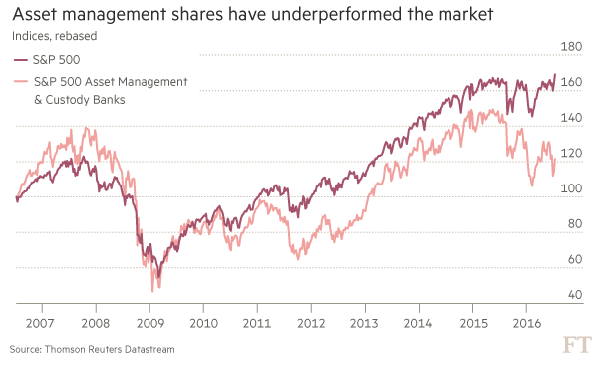
Active fails
Source: FT 17 July 2016 “Actively failing”
Notes:
Source: FT 17 July 2016 “Actively failing” https://next.ft.com/content/f50852ea-4812-11e6-8d68-72e9211e86ab?ftcamp=crm/email//nbe/Analysis/product

Slide 134
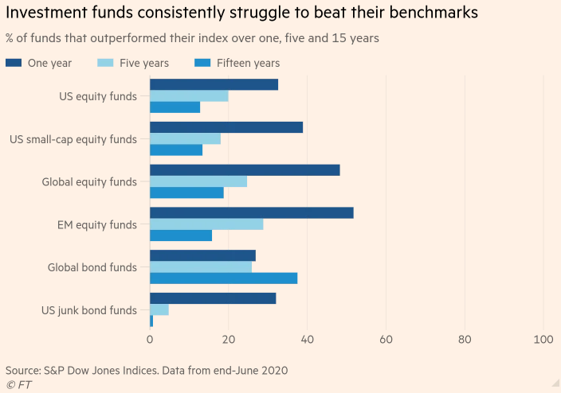
Index outperformance is hard to maintain
Source: FT 11 November 2020
Notes:
Source: FT 11 November 2020 “Active managers struggle to prove their worth” https://www.ft.com/content/621d51de-f732-48e3-b3e3-be83f42baec3?emailId=5fae92e9c672000004d2bbb9&segmentId=b24b7365-3058-3306-740e-9eeee4834a62

Slide 135
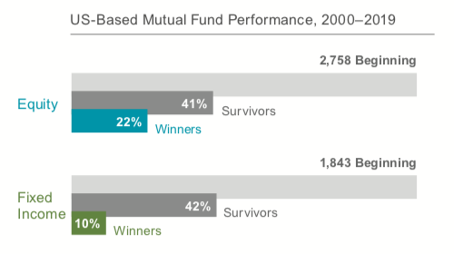
Performance of US stock mutual funds
Surprisingly, the vast majority of active managers did not even survive! They performed so poorly they went out of business or merged with other funds. Only 41% of stock mutual funds and 42% of bond mutual funds were still around after 20 years. Of the survivors, only 22% of stock funds and 10% of bond funds beat their index. The vast majority -- 78% and 90%, respectively, did worse
Notes:
Source: https://www.servowealth.com/blog/are-index-funds-the-best-way-to-invest
The chart below is from a study doneby Dimensional Fund Advisors. It looked at all US stock and bond mutual funds that were in business in 2000, then tracked their returns over the next two decades. Surprisingly, the vast majority of active managers did not even survive! They performed so poorly they went out of business or merged with other funds. Only 41% of stock mutual funds and 42% of bond mutual funds were still around after 20 years. Of the survivors, only 22% of stock funds and 10% of bond funds beat their index. The vast majority -- 78% and 90%, respectively, did worse.

Slide 136
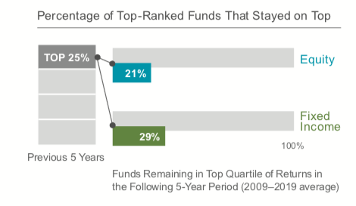
Performance of US stock mutual funds
Only 21% and 29% of stock and bond funds who out-performed managed to stay on top during the following five years. You'd expect similar results if you picked funds out of a hat
Notes:
Source: https://www.servowealth.com/blog/are-index-funds-the-best-way-to-invest
But what about the winners? Some outperformed, why not just invest in those instead of settling for index returns? Because we know who the out-performers have been, but we don't know who they will be. The DFA study also looked at the top performing 25% of stock and bond funds over all five-year periods, and then followed their returns over the subsequent five-years. Guess what they found? Previous winners don't repeat by any more than we'd expect by chance. Only 21% and 29% of stock and bond funds who out-performed managed to stay on top during the following five years. You'd expect similar results if you picked funds out Performance of US stock mutual fundsof a hat

Slide 137
Mutual Fund Costs
When you buy shares, you pay the current NAV per share plus any fee the fund assesses at the time of purchase, such as a purchase sales load or other type of purchase fee
When you sell your shares, the fund will pay you the NAV minus any fee the fund assesses at the time of redemption, such as a deferred (or back-end) sales load or redemption fee
Investors incur fees and/or expenses
Upfront and back-end fees
Load funds (class A shares) charge an upfront fee for buying the shares
No-load funds do not charge this fee
Deferred load (class B shares) funds charge a fee when the shares are redeemed
If the particular fund charges no front or back end fees, it is referred to as class C shares
Fund Operating Expenses
Notes:
A fund's NAV goes up or down daily as its holdings change in value.
Shareholders Fees:
Sales Charge (Load) on Purchases — the amount you pay when you buy shares in a mutual fund. Also known as a "front-end load," this fee typically goes to the brokers that sell the fund's shares. Front-end loads reduce the amount of your investment. For example, let's say you have $1,000 and want to invest it in a mutual fund with a 5% front-end load. The $50 sales load you must pay comes off the top, and the remaining $950 will be invested in the fund. According to NASD rules, a front-end load cannot be higher than 8.5% of your investment.
Purchase Fee — another type of fee that some funds charge their shareholders when they buy shares. Unlike a front-end sales load, a purchase fee is paid to the fund (not to a broker) and is typically imposed to defray some of the fund's costs associated with the purchase.
Deferred Sales Charge (Load) — a fee you pay when you sell your shares. Also known as a "back-end load," this fee typically goes to the brokers that sell the fund's shares. The most common type of back-end sales load is the "contingent deferred sales load" (also known as a "CDSC" or "CDSL"). The amount of this type of load will depend on how long the investor holds his or her shares and typically decreases to zero if the investor holds his or her shares long enough.
Redemption Fee — another type of fee that some funds charge their shareholders when they sell or redeem shares. Unlike a deferred sales load, a redemption fee is paid to the fund (not to a broker) and is typically used to defray fund costs associated with a shareholder's redemption.
Exchange Fee — a fee that some funds impose on shareholders if they exchange (transfer) to another fund within the same fund group or "family of funds.“
Account fee — a fee that some funds separately impose on investors in connection with the maintenance of their accounts. For example, some funds impose an account maintenance fee on accounts whose value is less than a certain dollar amount.
Annual Fund Operating Expenses
Management Fees — fees that are paid out of fund assets to the fund's investment adviser for investment portfolio management, any other management fees payable to the fund's investment adviser or its affiliates, and administrative fees payable to the investment adviser that are not included in the "Other Expenses" category (discussed below).
Distribution [and/or Service] Fees ("12b-1" Fees) — fees paid by the fund out of fund assets to cover the costs of marketing and selling fund shares and sometimes to cover the costs of providing shareholder services. "Distribution fees" include fees to compensate brokers and others who sell fund shares and to pay for advertising, the printing and mailing of prospectuses to new investors, and the printing and mailing of sales literature. "Shareholder Service Fees" are fees paid to persons to respond to investor inquiries and provide investors with information about their investments.
Other Expenses — expenses not included under "Management Fees" or "Distribution or Service (12b-1) Fees," such as any shareholder service expenses that are not already included in the 12b-1 fees, custodial expenses, legal and accounting expenses, transfer agent expenses, and other administrative expenses.
Total Annual Fund Operating Expenses ("Expense Ratio") — the line of the fee table that represents the total of all of a fund's annual fund operating expenses, expressed as a percentage of the fund's average net assets. Looking at the expense ratio can help you make comparisons among funds.
A Word About "No-Load" Funds Some funds call themselves "no-load." As the name implies, this means that the fund does not charge any type of sales load. But, as discussed above, not every type of shareholder fee is a "sales load." A no-load fund may charge fees that are not sales loads, such as purchase fees, redemption fees, exchange fees, and account fees. No-load funds will also have operating expenses.
A Word About Breakpoints Some mutual funds that charge front-end sales loads will charge lower sales loads for larger investments. The investment levels required to obtain a reduced sales load are commonly referred to as "breakpoints.“ The SEC does not require a fund to offer breakpoints in the fund's sales load. But, if breakpoints exist, the fund must disclose them. In addition, a NASD member brokerage firm should not sell you shares of a fund in an amount that is "just below" the fund's sales load breakpoint simply to earn a higher commission.

Slide 138
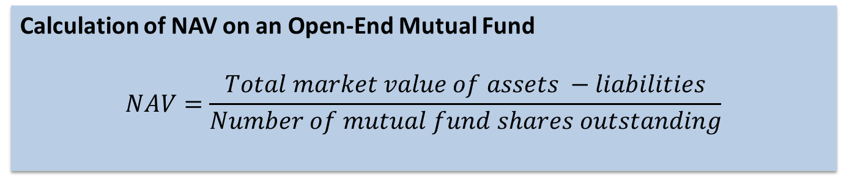
Calculating a Mutual Fund’s Net Asset Value (NAV)
NAV is the current market value of all the fund’s assets, minus liabilities (e.g., fund expenses), divided by the total number of outstanding shares
Calculation of NAV on an Open-End Mutual Fund
$$NAV=\frac{Total market value of assets −liabilities}{Number of mutual fund shares outstanding}$$
Notes:
HK: NAV (Net asset value) is derived by subtracting the liabilities of a fund from its total assets, and then divided it by the number of shares outstanding. Valuation of a fund is usually calculated daily and the NAV will fluctuate in line with the securities that the fund holds.
At present, there are primarily two methods of quotation, namely by net asset value ("NAV") or by bid/offer. Under NAV, fund prices are shown net of the subscription charges. You would redeem at NAV, and if you subscribe for the fund, you have to add the subscription charge to the NAV. As for bid and offer, the spread between the bid and offer prices represents the subscription charges. You would buy at the offer price and sell at the bid price.
Example:
Assume that for a fund:
Net asset value of the fund: US$50 million
Outstanding number of units: 10 million
Net asset value per unit: US$5
Initial charge: 5%
Then:
Bid price is US$5
Offer price is US$5 x 1.05 = US$5.25
(Source: http://www.icifactbook.org/fb_appa.html#organization
Fund Pricing: Net Asset Value and the Pricing Process)
By law, investors are able to redeem mutual fund shares each business day. As a result, fund shares are very liquid investments. Most mutual funds continually offer new shares to investors. Many fund companies also allow shareholders to transfer money—or make “exchanges”—from one fund to another within the same fund family. Mutual funds process investors’ sales, redemptions, and exchanges as a normal part of daily business activity and must ensure that all transactions receive the appropriate price.
The price per share at which shares are redeemed is known as the net asset value (NAV). NAV is the current market value of all the fund’s assets, minus liabilities (e.g., fund expenses), divided by the total number of outstanding shares (see illustration below). This calculation ensures that the value of each share in the fund is identical. An investor may determine the value of his or her pro rata share of the mutual fund by multiplying the number of shares owned by the fund’s NAV.
Federal law requires that a fund’s NAV be calculated at least once each trading day.
The price at which a fund’s shares may be purchased is its NAV per share plus any applicable front-end sales charge (the offering price of a fund without a sales charge would be the same as its NAV per share).
The 1940 Act requires “forward pricing,” meaning that shareholders who purchase or redeem shares must receive the next computed share price (NAV) following the fund’s receipt of the transaction order. Under forward pricing, orders received prior to 4:00 p.m. receive the price determined that same day at 4:00 p.m.; orders received after 4:00 p.m. receive the price determined at 4:00 p.m. on the next business day.
The NAV must reflect the current value of the fund’s securities. The value of these securities is determined either by a market quotation for those securities in which a market quotation is readily available, or if a market quotation is not readily available, a fair value as determined in good faith.

Slide 139
Fee Structure of Investment Funds
Other fees charges by mutual funds include:
Contingent deferred sales charge: A back end fee that may disappear altogether after a specific period
Redemption fee: Another name for a back end load
Exchange fee: A fee (usually low) for transferring money between funds in the same family
Account maintenance fee: Charges if the account balance is too low.
12b-1 fee: Fee to pay marketing, advertising, and commissions
Source: Mishkin/Eakins
Notes:
Exchanging Shares
A "family of funds" is a group of mutual funds that share administrative and distribution systems. Each fund in a family may have different investment objectives and follow different strategies.
Some funds offer exchange privileges within a family of funds, allowing shareholders to transfer their holdings from one fund to another as their investment goals or tolerance for risk change. While some funds impose fees for exchanges, most funds typically do not. To learn more about a fund's exchange policies, call the fund's toll-free number, visit its website, or read the "shareholder information" section of the prospectus.
Bear in mind that exchanges have tax consequences. Even if the fund doesn't charge you for the transfer, you'll be liable for any capital gain on the sale of your old shares — or, depending on the circumstances, eligible to take a capital loss. We'll discuss taxes in further detail below.
12b-1 Fees — fees paid by the fund out of fund assets to cover the costs of marketing and selling fund shares and sometimes to cover the costs of providing shareholder services. "Distribution fees" include fees to compensate brokers and others who sell fund shares and to pay for advertising, the printing and mailing of prospectuses to new investors, and the printing and mailing of sales literature. "Shareholder Service Fees" are fees paid to persons to respond to investor inquiries and provide investors with information about their investments.

Slide 140
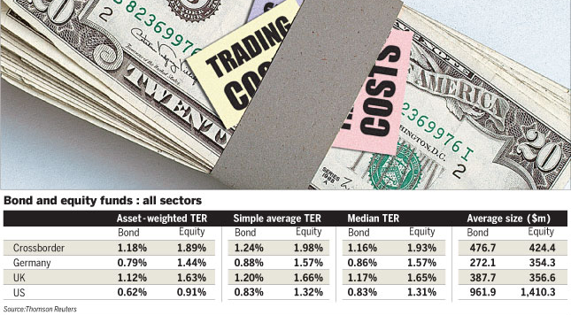
Funds Total Expense Ratio (TER)
“The established metric is the total expense ratio (TER), which includes charges such as the annual management fee, administration and legal fees and distribution fees. It does not include dealing costs, entry or exit fees (front-end and back-end loads) or performance fees.”
Source: “Call to reveal true fund costs to investors’”, FT 01.11.2009
Notes:
Source: Call to reveal true fund costs to investors
By Sophia Grene FT Published: November 1 2009 10:40 | Last updated: November 1 2009 10:40 http://www.ft.com/cms/s/0/ac01bb98-c585-11de-9b3b-00144feab49a,dwp_uuid=db00e994-f1d5-11dc-9b45-0000779fd2ac.html#
The established metric is the total expense ratio (TER), which includes charges such as the annual management fee, administration and legal fees and distribution fees. It does not include dealing costs, entry or exit fees (front-end and back-end loads) or performance fees.
Mr Miller proposes all funds should publish a table displaying the TER including dealing costs, front-end and back-end load, and any performance fee. It would not be sufficient to show these costs as percentages, so Mr Miller suggests a calculation of returns to the investors in a number of scenarios.
Ignoring the question of where one would draw the line in terms of scenarios – the impact of a 5 per cent front end load is different on an investment held for a year from one held for 10 years – this implies a very complicated set of information for investors to digest.
The UK does currently require funds to display a calculation called “reduction in yield” based on exactly the sort of scenario calculation Mr Miller likes, but without the inclusion of dealing costs.
Given that the Committee of European Securities Regulators (Cesr) has just decided that even the term TER is too difficult for investors to grasp and should be replaced by the phrase “ongoing management charges”, Mr Miller’s proposal loses some of its consumer-protection strength.
Simplicity is not the only reason to defend the TER, according to other industry commentators. A significant defence of the TER is that “of all data points in the fund industry, it has the most predictive power”, in the words of Russell Kinnel, director of mutual fund research at Morningstar.
This means the expense ratio achieved last year is likely to be repeated next year, with minor variations. Trading costs, on the other hand, are both less predictable and less easy to pin down.
In the US, the brokerage costs, which include just the commission paid for a transaction, not its market impact, are routinely disclosed.
Lipper Fitzrovia, which has been campaigning for the TER to be given greater prominence in Europe since 1993, uses this definition of portfolio turnover rate, but the current European Ucits regulations call for a different version.
However, perhaps because of this confusion in how to calculate it, the new key information document (Kid) for Ucits IV that will replace the simplified prospectus will no longer include portfolio turnover, again on the grounds that investors were not interested or did not understand the meaning of the figure.
Trading costs, however arrived at, are also going to be left out of the Kid, even though Cesr admits they have an impact on the investment performance of funds. This brings us back to another advantage of the TER – that it is robustly comparable across different asset classes and different jurisdictions. In Europe, where the authorities in Brussels are attempting to build a single market in financial services across 27 countries, this is a significant advantage.

Slide 141
Mutual Fund Expense Ratios Tend to Fall as Fund Assets Rise Share classes of actively managed domestic equity mutual funds continuously in existence since 2000
ICI Fact Book 2020

Slide 142
Expense Ratio of Actively Managed and Index Mutual Funds Have Fallen Percent, 2000-2019
ICI Fact Book 2020
Notes:
ICI Fact Book 2020

Slide 143
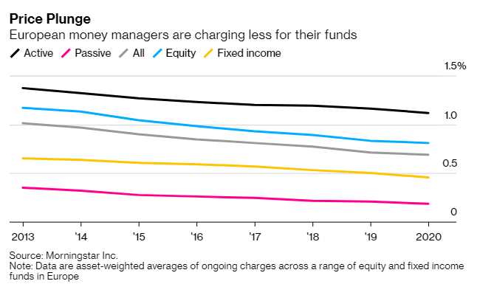
Fund fees in decline
Source: Bloomberg
Notes:
Source: Bloomberg https://www.bloomberg.com/news/articles/2020-12-08/money-managers-record-low-fees-are-about-to-sink-even-lower?cmpid=BBD120820_MKT&utm_medium=email&utm_source=newsletter&utm_term=201208&utm_campaign=markets&sref=INmNRPZ9

Slide 144
Returns from Mutual Funds
You can earn money from your investment in three ways:
Dividend Payments — A fund may earn income in the form of dividends and interest on the securities in its portfolio. The fund then pays its shareholders nearly all of the income (minus disclosed expenses) it has earned in the form of dividends.
Capital Gains Distributions — The price of the securities a fund owns may increase. When a fund sells a security that has increased in price, the fund has a capital gain. At the end of the year, most funds distribute these capital gains (minus any capital losses) to investors
Increased NAV — If the market value of a fund's portfolio increases after deduction of expenses and liabilities, then the value (NAV) of the fund and its shares increases. The higher NAV reflects the higher value of your investment.
With respect to dividend payments and capital gains distributions, funds usually will give you a choice: the fund can send you a check or other form of payment, or you can have your dividends or distributions reinvested in the fund to buy more shares (often without paying an additional sales load).
Source: SEC

Slide 145
Summary
Mutual Funds (ct’d):
Disclosure requirements
Performance (absolute v. relative returns)
Costs , expenses and TER
NAV
returns

Slide 146
Test Your Understanding
One key issue for investors in collective investment funds is the costs involved. One of the metrics used to compare funds is the TER (Total Expense Ratio). Which of the following costs is not included in the TER?
Annual management fee
Dealing costs
Administration and legal fees
Distribution fees
In the US “breaking the buck” refers to a situation where:
the Euro spot price (EUR/USD) falls below 1 USD
a Money Market Mutual Fund (MMMF)’s NAV (Net Asset Value) goes below $1
the NAV of a mutual fund exceeds $1 per share

Slide 147
Collective Investments Schemes in Hong Kong
Regulation: Protection of Investors Ordinance; Regulator: the SFC; SFC’s Code on Unit Trusts & Mutual Funds details the requirements applicable to such schemes in Hong Kong
Licensing and registration: only entities registered with the SFC can distribute mutual funds and unit trusts in HK ; licenses are required to distribute funds (registered dealer or advisor)
The SFC reviews and authorizes offering documents of retail investment products, pursuant to the SFO or the Companies Ordinance.
Information requirements include: prospectus, audited annual report, unaudited semi-annual report and other pertinent information; after investments, regular statements (monthly/quarterly) have to be provided to investors including valuation as well as number of units
Notes:
The most important piece of legislation in relation to the marketing of investment products is the Protection of Investors Ordinance. The Ordinance prescribes that unless authorized by the SFC, no advertisements can be issued in Hong Kong. Selling unauthorized funds to the general public will constitute an infringement of law which involves fines and/or imprisonment.
What role does SFC assume in the regulation of funds?
Investment products:
Approves fund managers, in connection with authorized funds
Authorizes funds
Licensing:
Licenses financial intermediaries (including fund managers) which carry on a business of dealing in or advising on securities in Hong Kong
Intermediaries supervision:
Inspects the activities of licensed financial intermediaries (including fund managers) in Hong Kong
To be "authorized", a fund must satisfy the following requirements:
Clear and full disclosure in English and Chinese:
Appropriate safeguards: The fund must appoint an independent and qualified trustee or custodian which holds the fund's assets in trust for investors, and monitors the investments made by the fund managers. Also, the SFC will check the background of the fund manager to ensure that he has the necessary expertise, experience and is "fit and proper" to manage the funds.
Presence of a Hong Kong representative: If a fund is promoted or managed by an overseas fund manager, it must appoint a Hong Kong representative with which Hong Kong investors can deal.
Diversified investment policy: To be authorized, the fund must adhere to certain investment restrictions and guidelines. The basic principle is that the fund must be liquid and diversified.
Accurate adverts and marketing materials: All adverts and marketing materials have to be vetted by the SFC before publication. The SFC will ensure that they do not contain false, biased or misleading information.
Other structural requirements: There are other structural and operational requirements imposed on a fund, e.g. preparation of semiannual and audited annual financial reports, and limitations on the types of fees which may be charged to a fund.
Over 95% of the authorized funds are not domiciled in Hong Kong, but in other jurisdictions such as Luxembourg, the Channel Islands, Cayman Islands, Bermuda or Bahamas. The reason for these locations are either because they tend to be tax-free places or places where a fund, once established, can be widely marketed around the world.
SFC allows non-HK domiciled funds to be authorized here, but they still are required to meet the SFC standards as would apply to a locally domiciled fund. Most of the jurisdictions referred to above have their own securities commissions, and apply high standards to the fund before it is allowed to be offered to the public.

Slide 148
Collective Investments Schemes in Hong Kong
The SFC does not approve retail investment products: it reviews and authorizes offering documents of retail investment products
Assessment of whether a recommendation is suitable for an individual investor must be done by the selling intermediary at the point of sale, taking into consideration the investor’s personal circumstances including his or her investment objectives and risk appetite.
SFC Authorized Retail Funds Include Unit Trusts & Mutual Funds
Notes:
Source: http://www.sfc.hk/sfc/doc/EN/speeches/public/sfc_guide/WhoWeAreWhatWeDo.pdf

Slide 149
Operation of Mutual Funds and Unit Trusts in HK
Source: HKIFA
Notes:
Both trustees and custodians have fiduciary responsibilities, meaning that they are entrusted to properly represent the interests of investors by standing between the fund manager and the investors. Under law, a trustee owes a higher degree of care than a custodian in that it is responsible to perform a supervisory role in overseeing the fund operation. The trustee must ensure that the fund manager is fit and proper to act in its capacity, that the fund is being administered in accordance with the trust deed and any other regulations, that the assets are under the trustee's control, that the fund is being priced correctly and that distributions made to investors are properly handled and monitored.
The custodian's primary responsibilities include safekeeping of the fund's assets, settling of trades and collecting dividends.
In Hong Kong, the SFC requires the custodian of an authorized mutual fund to provide the same level of care as a trustee. Therefore, investors in authorized funds are offered the same level of protection whether investing in a unit trust or a mutual fund.

Slide 150
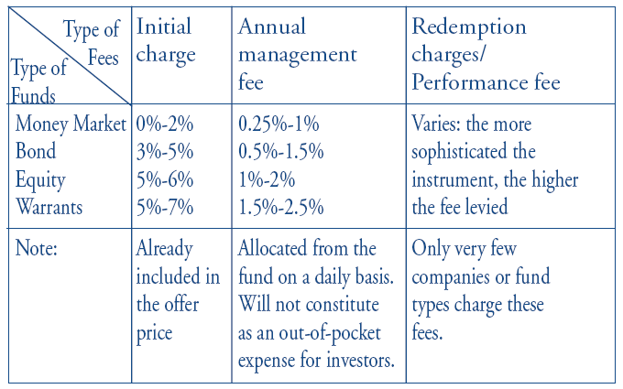
Fee Structure for Funds in HK
Source: HKIFA
Notes:
When you invest in a fund, there are basically two types of fees you have to pay:
Initial subscription charge or the front-end fee; and
Annual management fee
In addition, some funds may charge a redemption fee (especially for no-load funds) and performance fees (mainly for funds that invest in very sophisticated instruments.) Moreover, each fund would have fees charged by service providers, e.g. the trustee/custodian, administrator, etc. There are also other out-of-pocket expenses directly charged to the fund.
How much are these fees?
The fees are generally computed based on the net asset value of the fund.
The table is for reference only and investors should refer to the fund prospectus for detailed costs.
The initial subscription charge is paid up-front, i.e. you have to pay when you subscribe. For example, if you invest US$1,000 in a fund,
the fund company will either:
Deduct 5% from your investment, and the net investable amount would be US$950; or:
Gross up the amount so that the total you have to pay would be US$1,050; and your investable amount would be US$1,000.
On the annual management fee, you don't have to pay out-of-pocket separately. The fund will accrue it on a daily or a weekly basis, and deduct it from the pool of the money before the returns are divided amongst investors. The net asset value quoted is already net of the
annual fee.
As for redemption fees, they are usually computed based on the NAV, and are charged on exit, based on a sliding scale. This fee is usually charged if no-front-end is levied. Usually, the longer you invest, the lower the redemption fees you will have to pay.

Slide 151
Current issues:Mutual Funds in Asia: industry development and main issues. Practical examples in HK?(Group 11)
Video
https://www.youtube.com/watch?v=nasqlcXp0no
Article
https://www.pwc.com/gx/en/industries/financial-services/asset-management/publications/asset-management-insights/set-for-growth/the-future-of-funds-distribution-in-asia.html

Slide 152
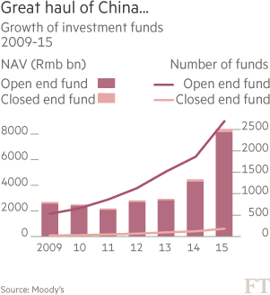
China’s asset management industry
AuM in China’s fund industry rose by 87% in 2015 to more than RMB 8Tr (US$1.2Trn), driven primarily by a 109% rise in assets of MMF to US$684BN
China now has the 2nd largest MMF sector in the world after the US and ahead of Ireland, with 14% of AuM.
Source: FT “China’s fund management industry almost doubles in 2015” 1 July 2016
Notes:
Source: FT “China’s fund management industry almost doubles in 2015” 1 July 2016 https://next.ft.com/content/d5a06cc2-3eca-11e6-8716-a4a71e8140b0?ftcamp=crm/email//nbe/FTfm/product

Slide 153
US Households Have More of Their Wealth in Regulated Funds; Chinese Households Have a Lower Share Percentage of households’ financial wealth, 2017

Slide 154
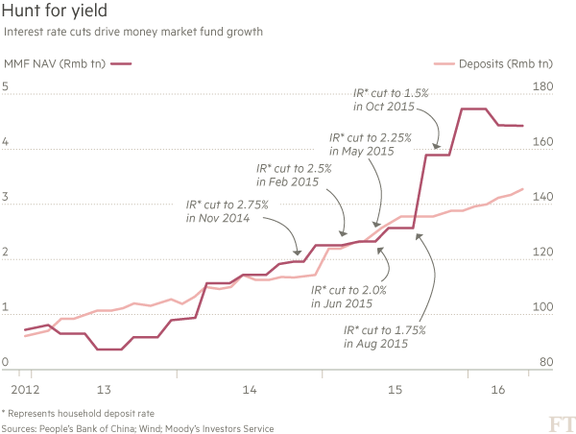
The rise of MMF in China
Demand for MMF was driven by 6 interest rate cuts from Nov 14 to Oct 15, slashing deposit rates from 3% to 1.5%; currently savings account deposit rates quoted by large banks is 0.3 to 0.35%
By contrast Yu’e Bao yields 2.4%
Source: FT “China’s fund management industry almost doubles in 2015” 1 July 2016
Notes:
Source: FT “China’s fund management industry almost doubles in 2015” 1 July 2016 https://next.ft.com/content/d5a06cc2-3eca-11e6-8716-a4a71e8140b0?ftcamp=crm/email//nbe/FTfm/product

Slide 155
Net Sales of Money Market Funds in the Asia-Pacific Region Are Related to Chinese Money Market Instrument Returns Annual, 2008–2017

Slide 156
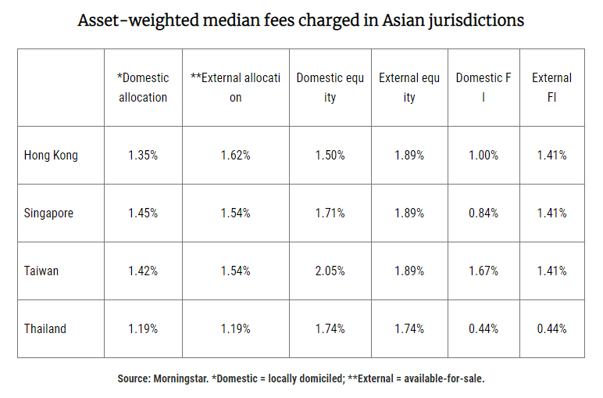
Mutual Fund Fees in Asia (2019)
Source: Morningstar
Notes:
Source: Morningstar https://fundselectorasia.com/hong-kongs-fund-fees-too-high/

Slide 157
Current issues in mutual funds and asset management
Regulators focus on “shadow banking” possible systemic role
The floating v. stable NAV debate
Capital reserve requirement
Growth of ETFs
ETFs v. ETPs – the issue of counterparty risk
Collateral requirements
Performance and returns
The active v. passive debate
The great rebalancing?

Slide 158
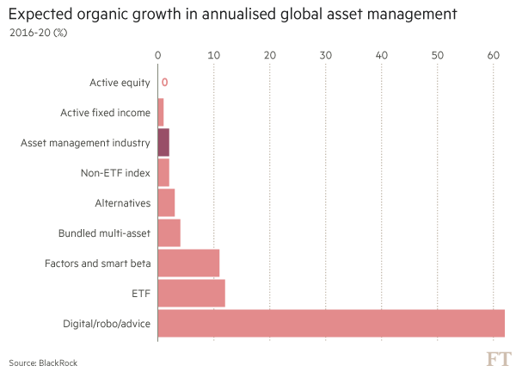
Growth in asset management
Source: FT 17 July 2016 “Actively failing”
Notes:
Source: FT 17 July 2016 “Actively failing” https://next.ft.com/content/f50852ea-4812-11e6-8d68-72e9211e86ab?ftcamp=crm/email//nbe/Analysis/product

Slide 159
Summary
collective investments schemes in HK
Regulation
Suitability standard (v. fiduciary duty)
Regulatory concerns in asset management

Slide 160
Test Your Understanding
In Hong Kong, the SFC is responsible for
Approving retail investment products
Authorizing offering documents of retail investment products
Assessing whether a product is suitable for individual investors
why does the SFC (and other regulators) worry about the rapid growth of synthetic ETFs?
They don’t understand the products
They worry that investors don’t realize they are taking counterparty exposure
They worry about systemic risk

